Slide 1
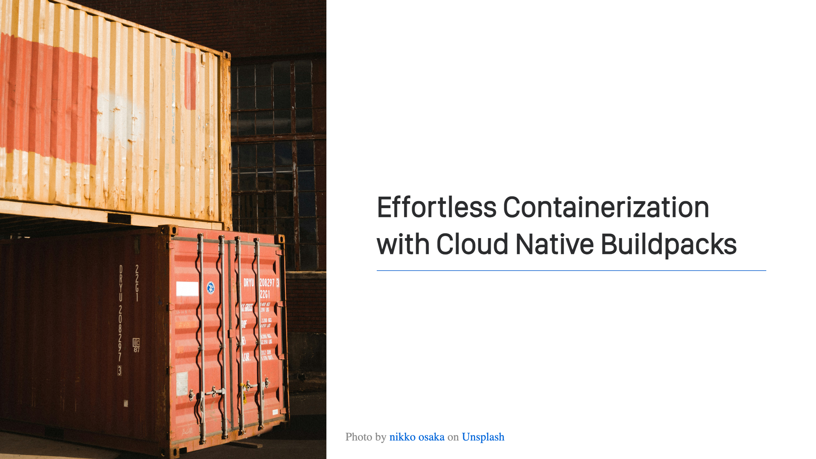
Notes:
Welcome! This is my session. Let's get started!

Slide 2
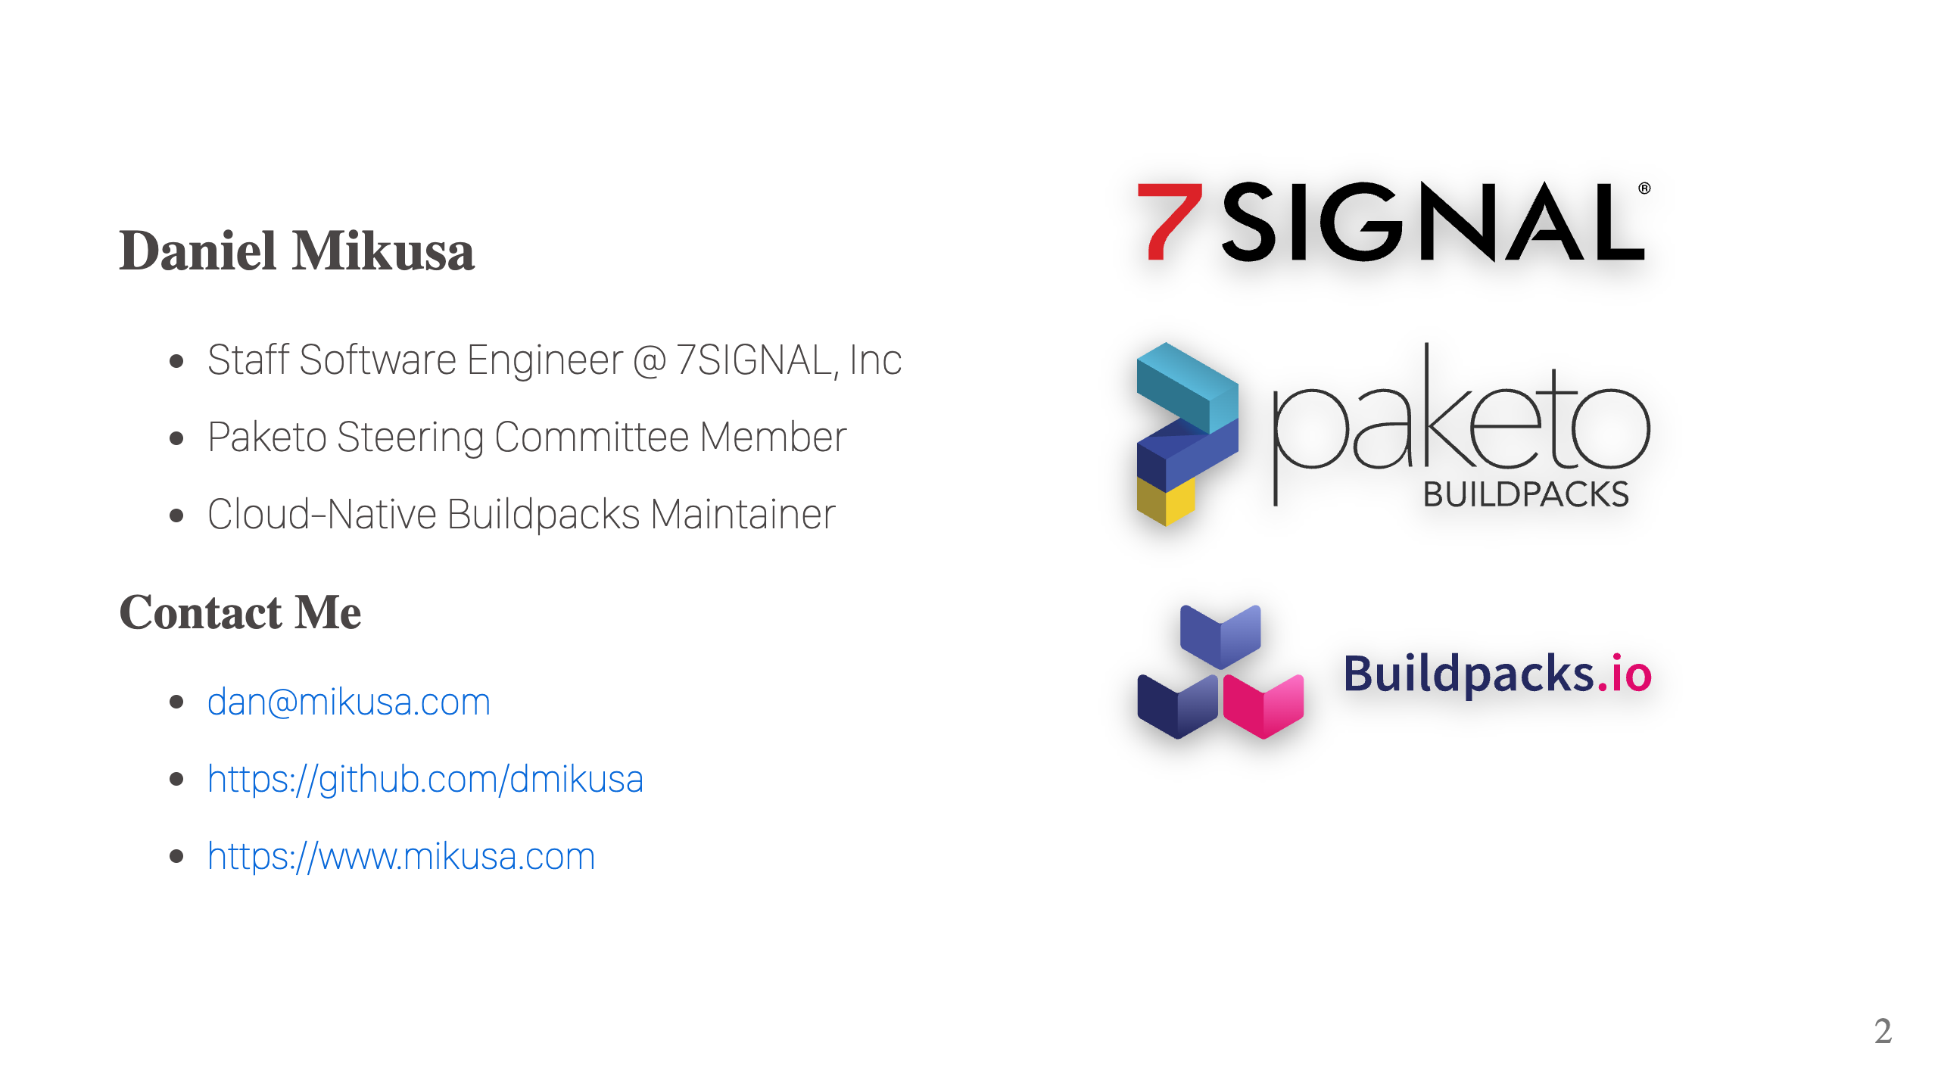
Notes:
Who am I? I work at 7SIGNAL, a leader in WiFi optimization. In a nutshell, we write performance monitoring software that helps make your WiFi awesome. I also help with a couple of OSS projects, Cloud-Native Buildpacks and Paketo Buildpacks. Both, great tools for building your container images and the subject of today's discussion. While I'm not covering WiFi in this talk, if you're curious feel free to come chat after the session.

Slide 3
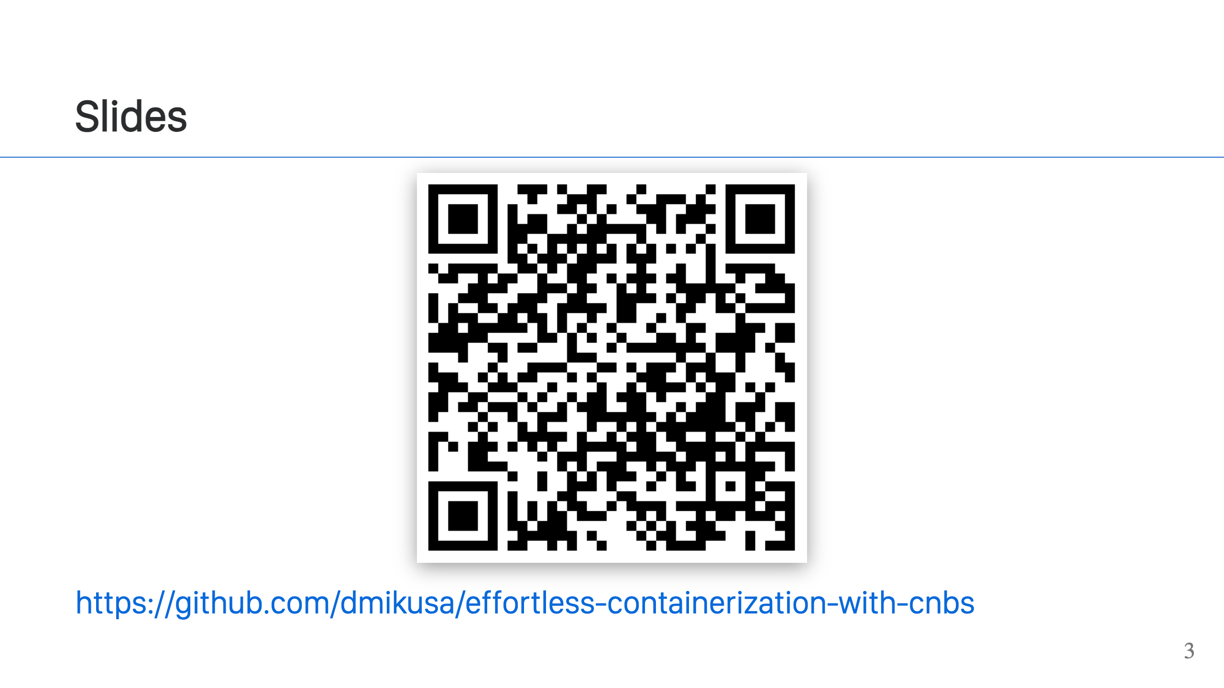
Notes:
Slides are available at the link above.

Slide 4
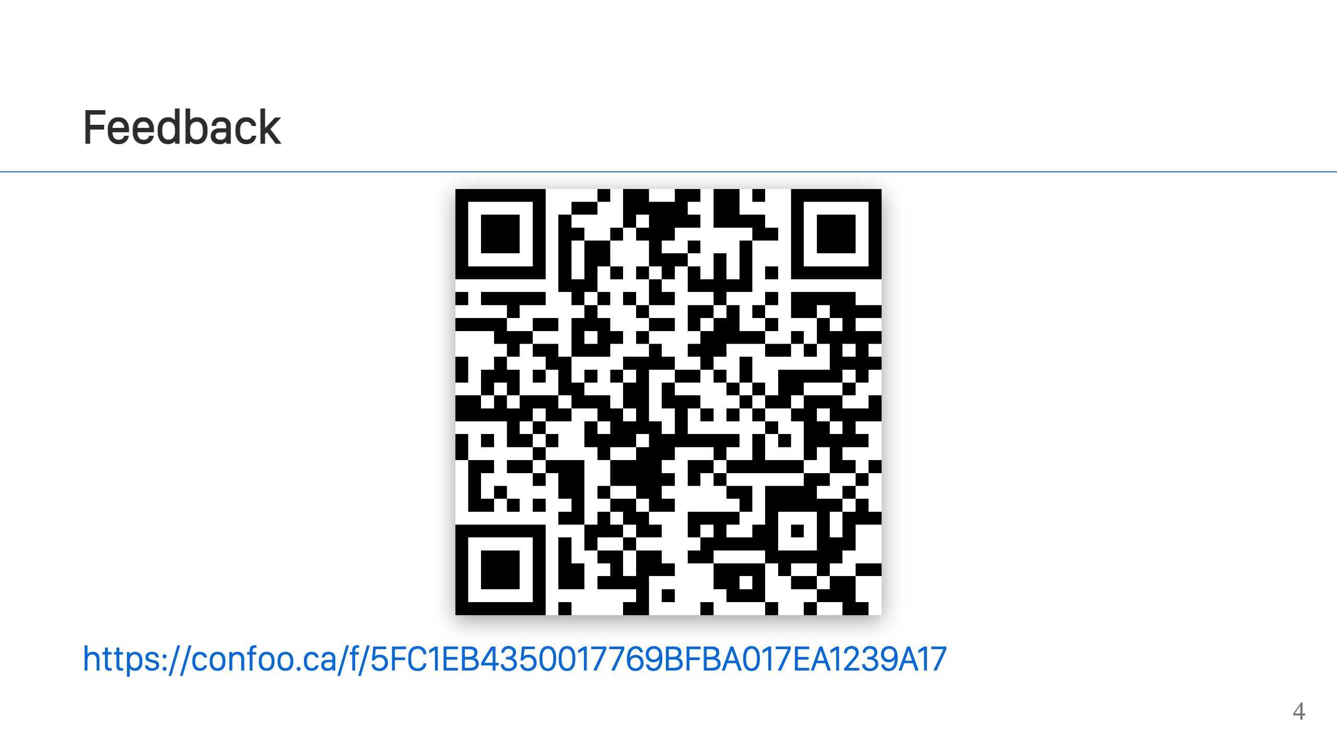
Notes:
Feedback can be left at this link. It's open for 1 hour after the talk.

Slide 5
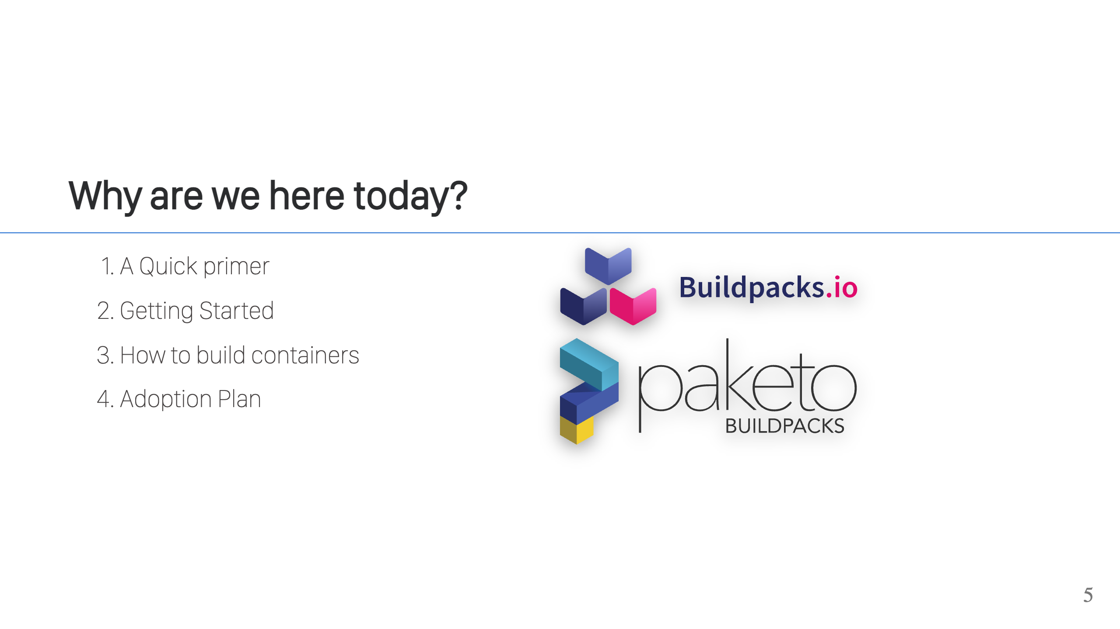

Slide 6
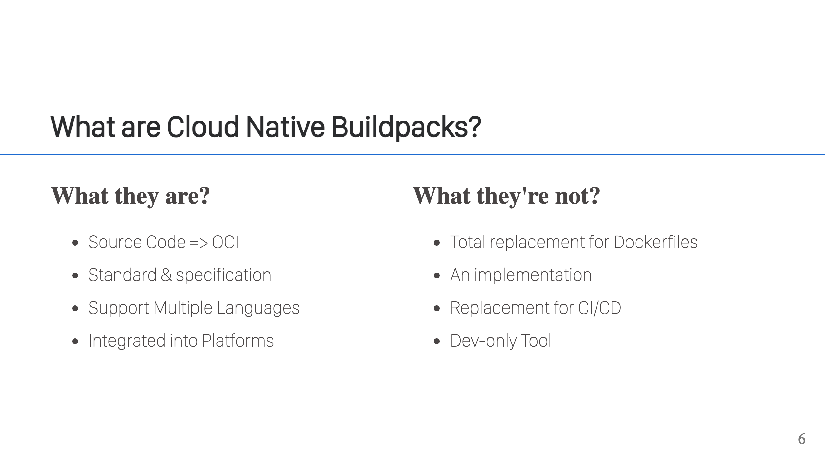
Notes:
What they are: - CNBs have a focused purpose, to turn source code into OCI images. - They are a general standard and support many different languages. - They are suited well for integration into platforms and are in many already (CF, Heroku, Fly.io, AWS AppRunner, Google Cloud Run) - They are a specification (platform + buildpacks). It defines how buildpacks work and how you integrate them into your platforms. What they are not: - They do not attempt to completely replace Dockerfiles. There are still some good use cases for Dockerfiles. They do replace Dockerfiles for use when it comes to building application containers. - They're not replacing CI/CD, although there are some common parts to both. Both build your app, both create artifacts. CNBs are usually integrated into your existing CI/CD pipelines some point after tests have run. - They're not a dev-only tool. They're great for Ops folks too, and that's what we're talking about today. - They're not an implementation. CNB does not provide a working set of buildpacks, which is where Paketo buildpacks come in. Paketo is an implementation of the CNB specification for most popular languages: Java, .NET, Python, Node.js, Ruby, Go, Rust, PHP, and Web Servers.

Slide 7
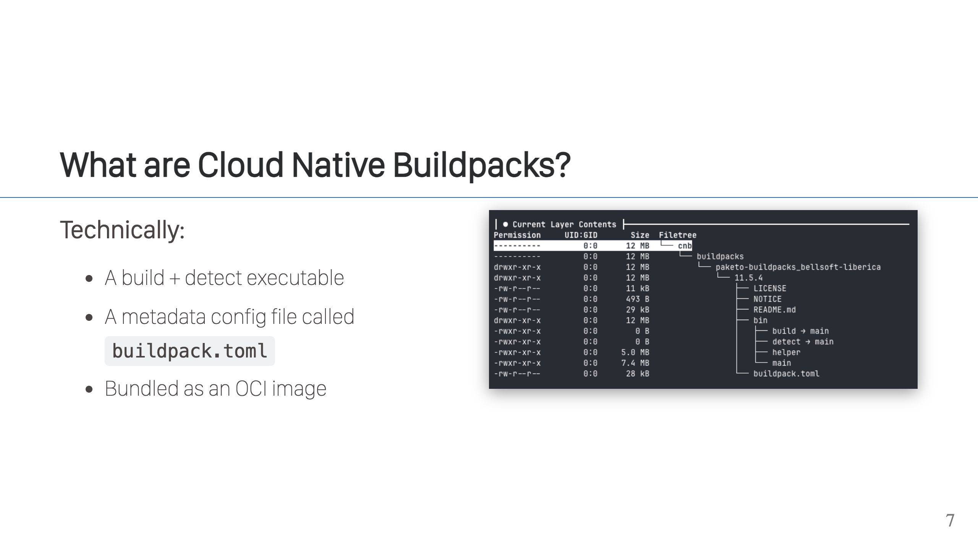

Slide 8
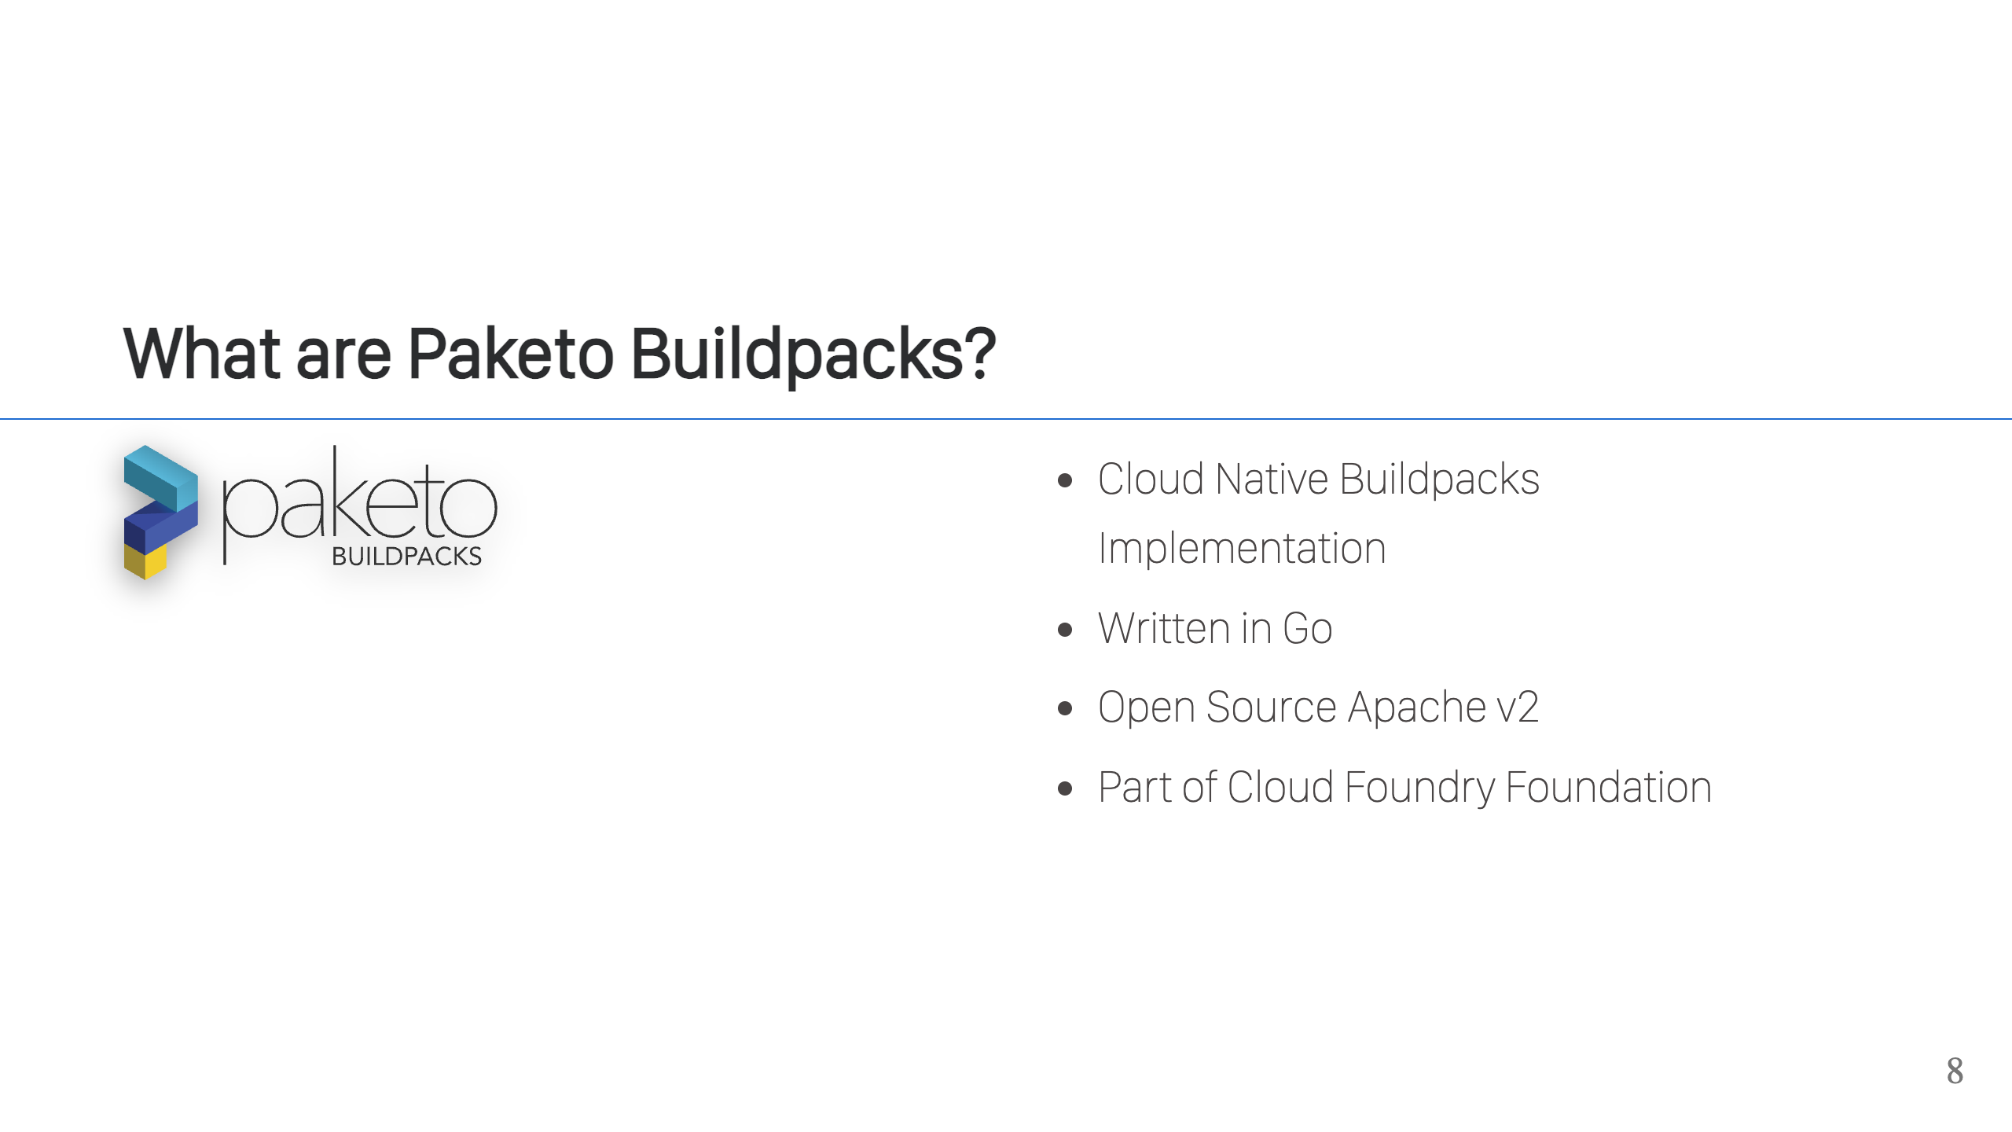
Notes:
Paketo Buildpacks are an implementation of the Cloud Native Buildpacks specification. // TODO: finish

Slide 9
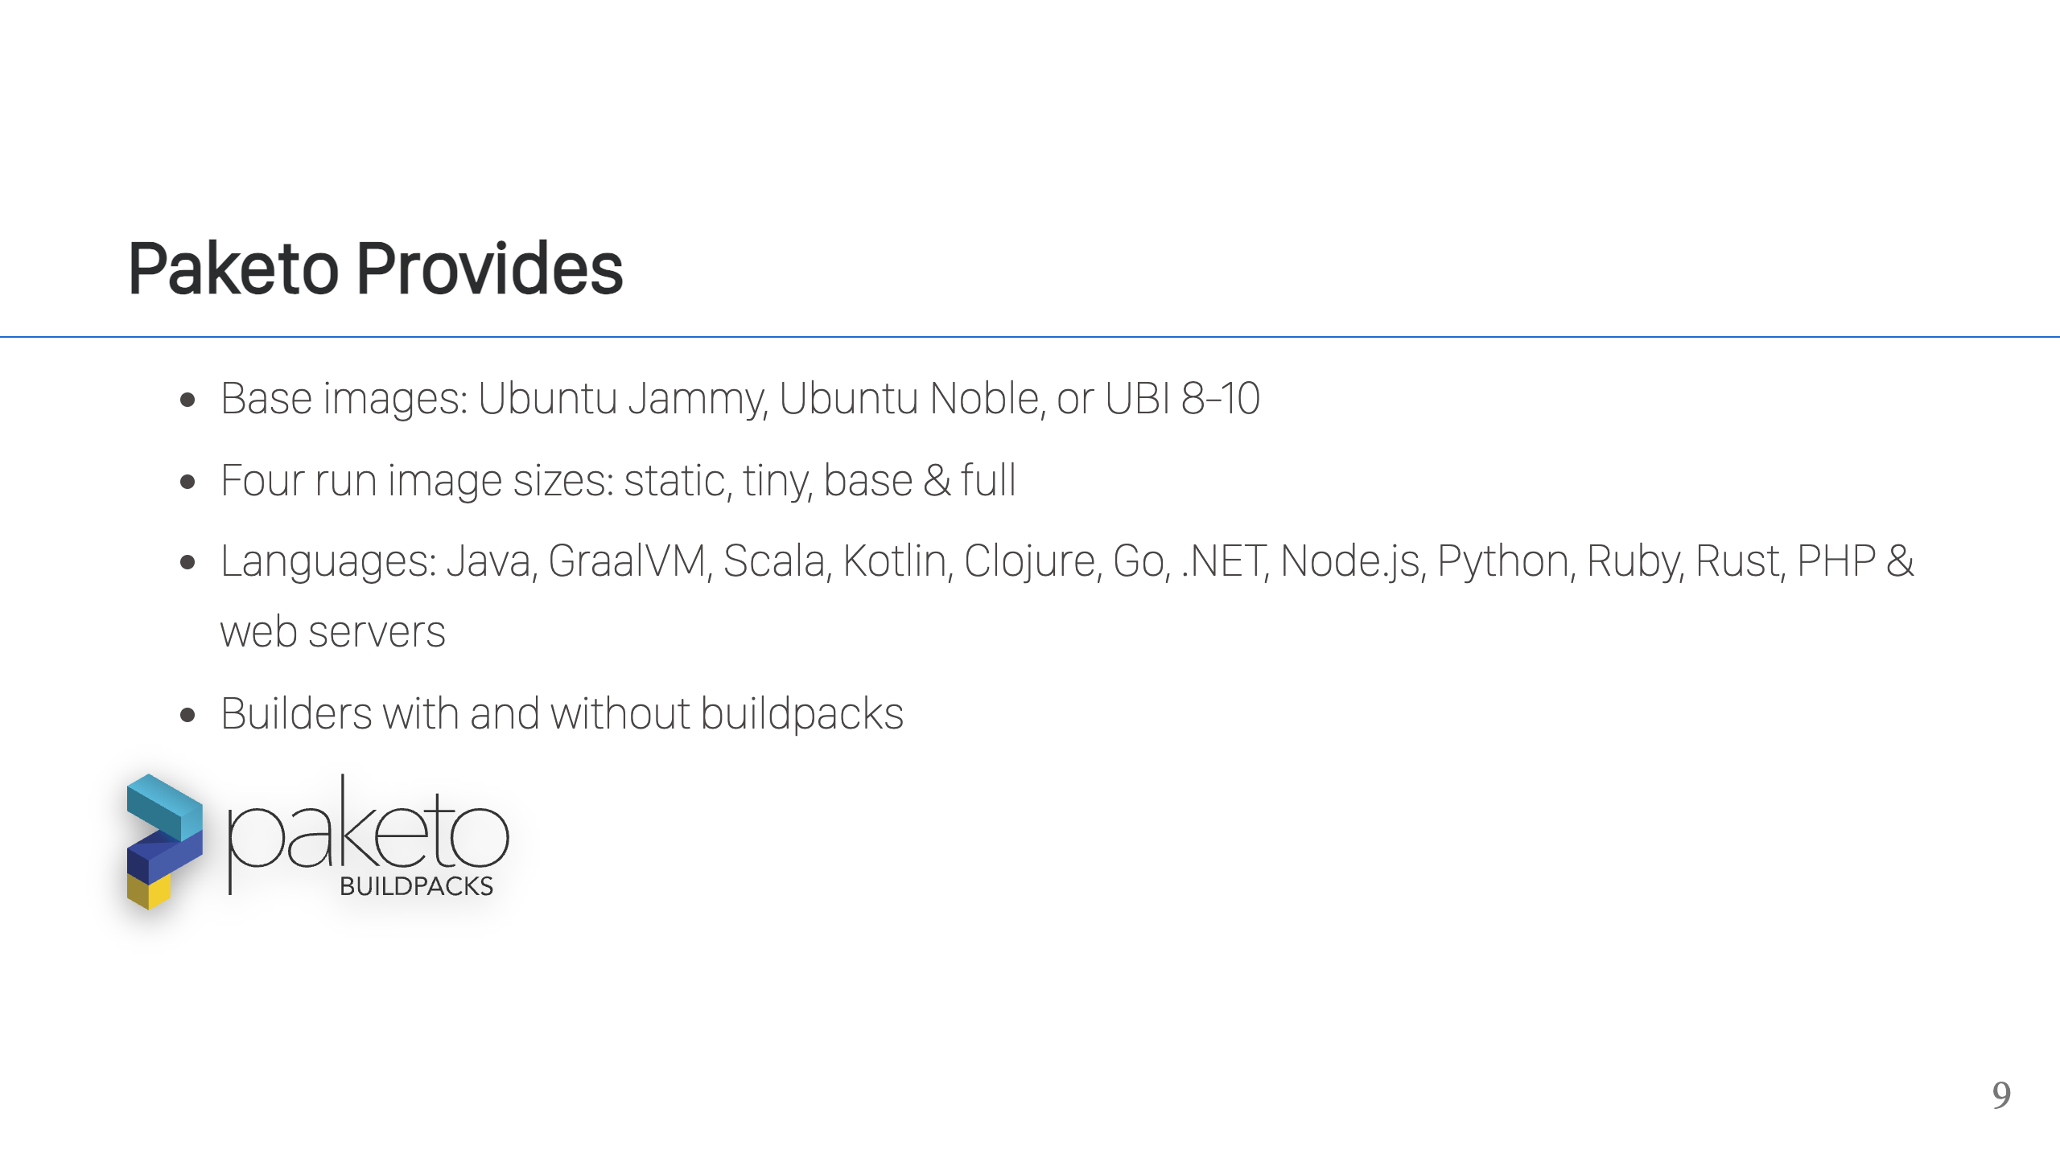
Notes:
Paketo provides you with a complete set of everything you need to run Cloud Native buildpacks. This includes: - A choice of base images. These provide the foundation images used for your build and run environments. Paketo provides some choices so you can pick what works best for your company. - If using the Ubuntu images, we provide four different size run images. These are the images where your application will run. The four different sizes allow you to choose the base size of your application images and what will be included in those images. - Paketo provides support for a large number of popular languages. - Paketo provides builders. Builders are the image that you point your build tool too. It's essentially the combination of base images + a set of buildpacks. Paketo provides builders for each of the base image sets listed above and includes the supported set of buildpacks for each builder. We also ship what are called "buildpack-less" builders, which are the same base images but without any buildpacks. There are some special cases when you're customizing buildpacks, where these buildpack-less builders can be helpful.

Slide 10
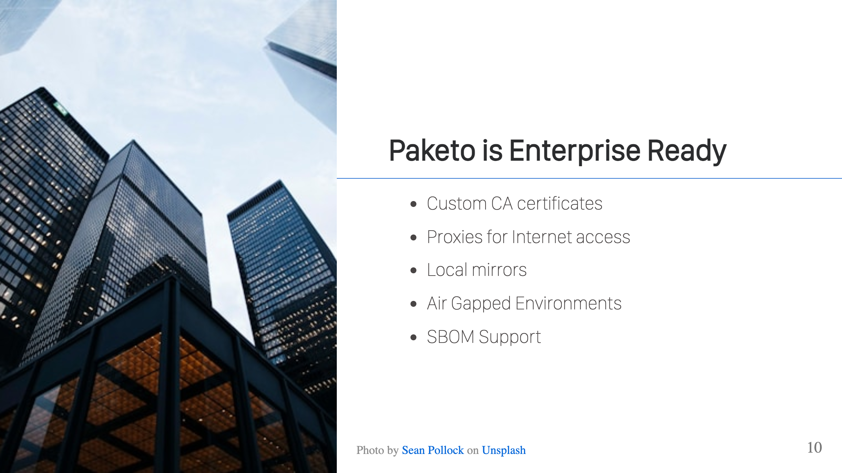
Notes:
Buildpacks are Enterprise ready. Many enterprises need things like proxy support for access to the Internet, or possibly to support a custom CA cert chain because their network intercepts TLS traffic to decrypt it. Paketo Buildpacks supports all of this. Some companies may not allow internet access at all, or certain parts of the company network may be air gapped. In these cases, Paketo has two options for you. You may run a local mirror for dependencies and a local registry for images. Another option that Paketo supports is to bundle dependencies into your buildpack images and use a local registry for images. As supply chain issue increase, companies are investing more into provenance and SBOM support. Fortunately, for Paketo buildpacks you get that out-of-the-box. We'll see this more in the demos.

Slide 11
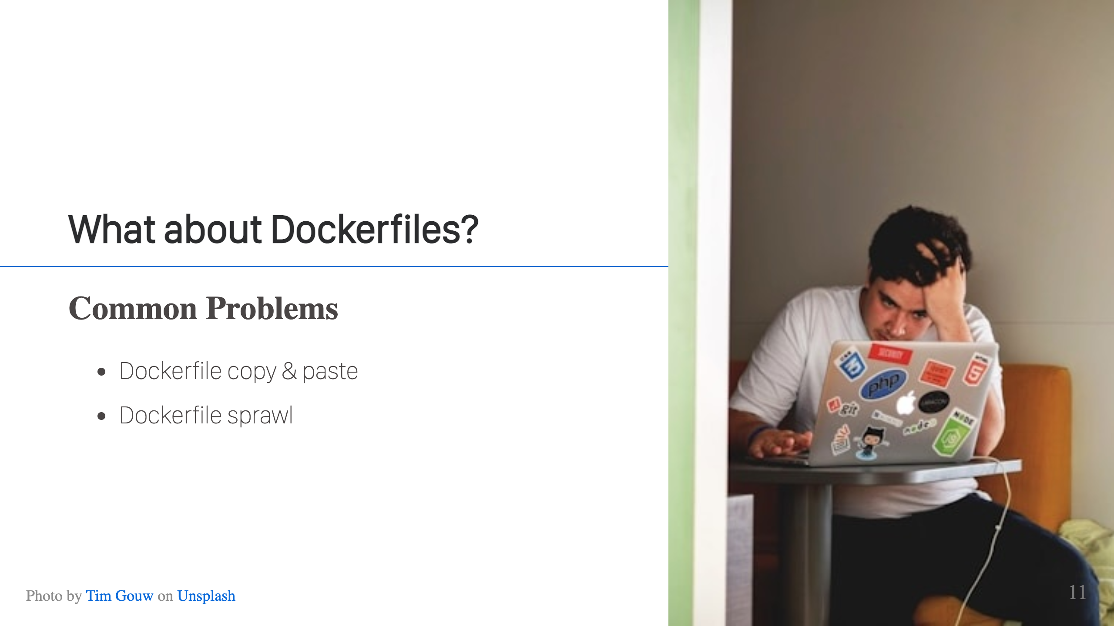
Notes:
You need to containerize an app. Where do you get the Dockerfile? a.) Copy & Paste from another repo b.) Copy & Paste from Stack Overflow or a blog post c.) Let AI tools generate it Most people don't have time to sit and generate one from scratch, check that it's following all the best practices (or even know of them), so any issues or problems get copied and pasted with the Dockerfile. If you have enough applications at your company, then you hit a new issue. What happens when you want to update all of these unique Dockerfiles? You need to analyze them, because there may be differences in the files, and then buckle in to submit a whole bunch of pull requests. It's not a fun process. Cloud Native buildpacks have no Dockerfiles, so this problem is gone. The knowledge and commands in the Dockerfiles are codified in the buildpacks & shared that way.

Slide 12
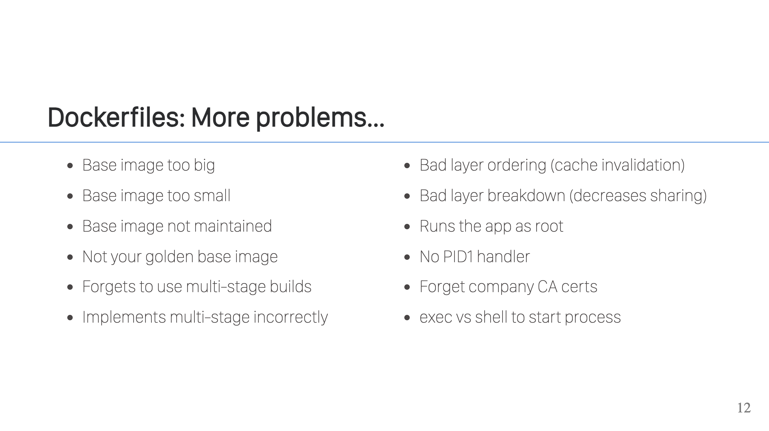
Notes:
Dockerfiles are easy to write, but hard to get correct. A quick search will show you tons of articles talking about the "best practices" you should follow when writing a Dockerfile. There are dozens of them, some are obvious and some can be pretty subtle. As a busy developer, you may be unaware of these best practices or you may not have the time to go through them all. As mentioned earlier, copy & paste is the most common way to create a Dockerfile, so you're just hoping someone else before you put in the time to do this right. The great thing about Buildpacks is that you don't have to hope. The buildpack authors put in the time to get it right, and codify that knowledge so every time you run the buildpack, things are done correctly and you get the best possible image.

Slide 13
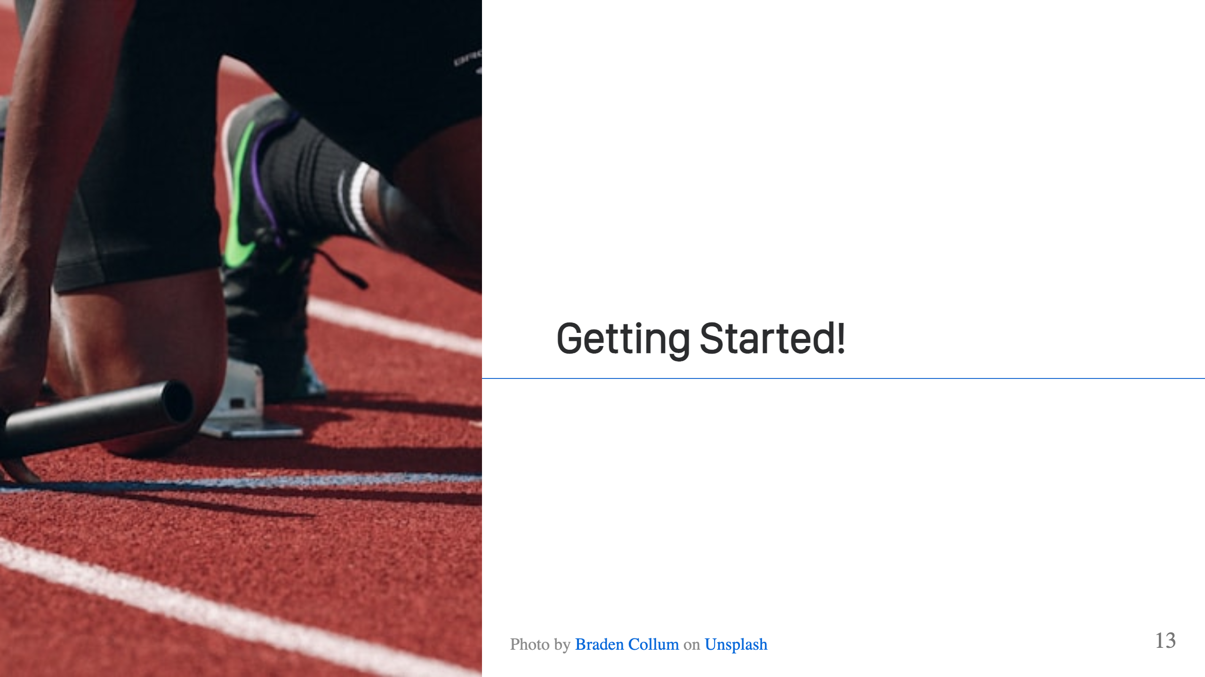

Slide 14
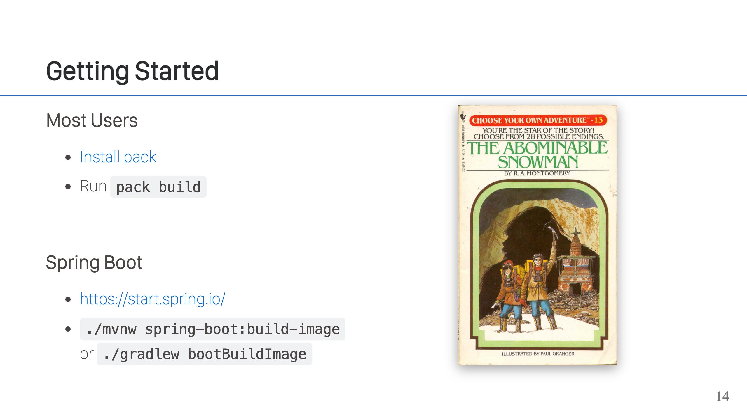
Notes:
For most users, you'll install pack. That can be done using a variety of package manager across MacOS, Windows and Linux, plus with bash, fish, and zsh, you can also set up auto completions. It's also distributed as a container itself, if that's more convenient. If you're a Spring Boot user, you're in luck! The Spring team provides Maven and Gradle plugins so you get support out-of-the-box. If you create your Spring project on https://start.spring.io/, things will be automatically set up and you can just run the appropriate command to trigger a build.

Slide 15
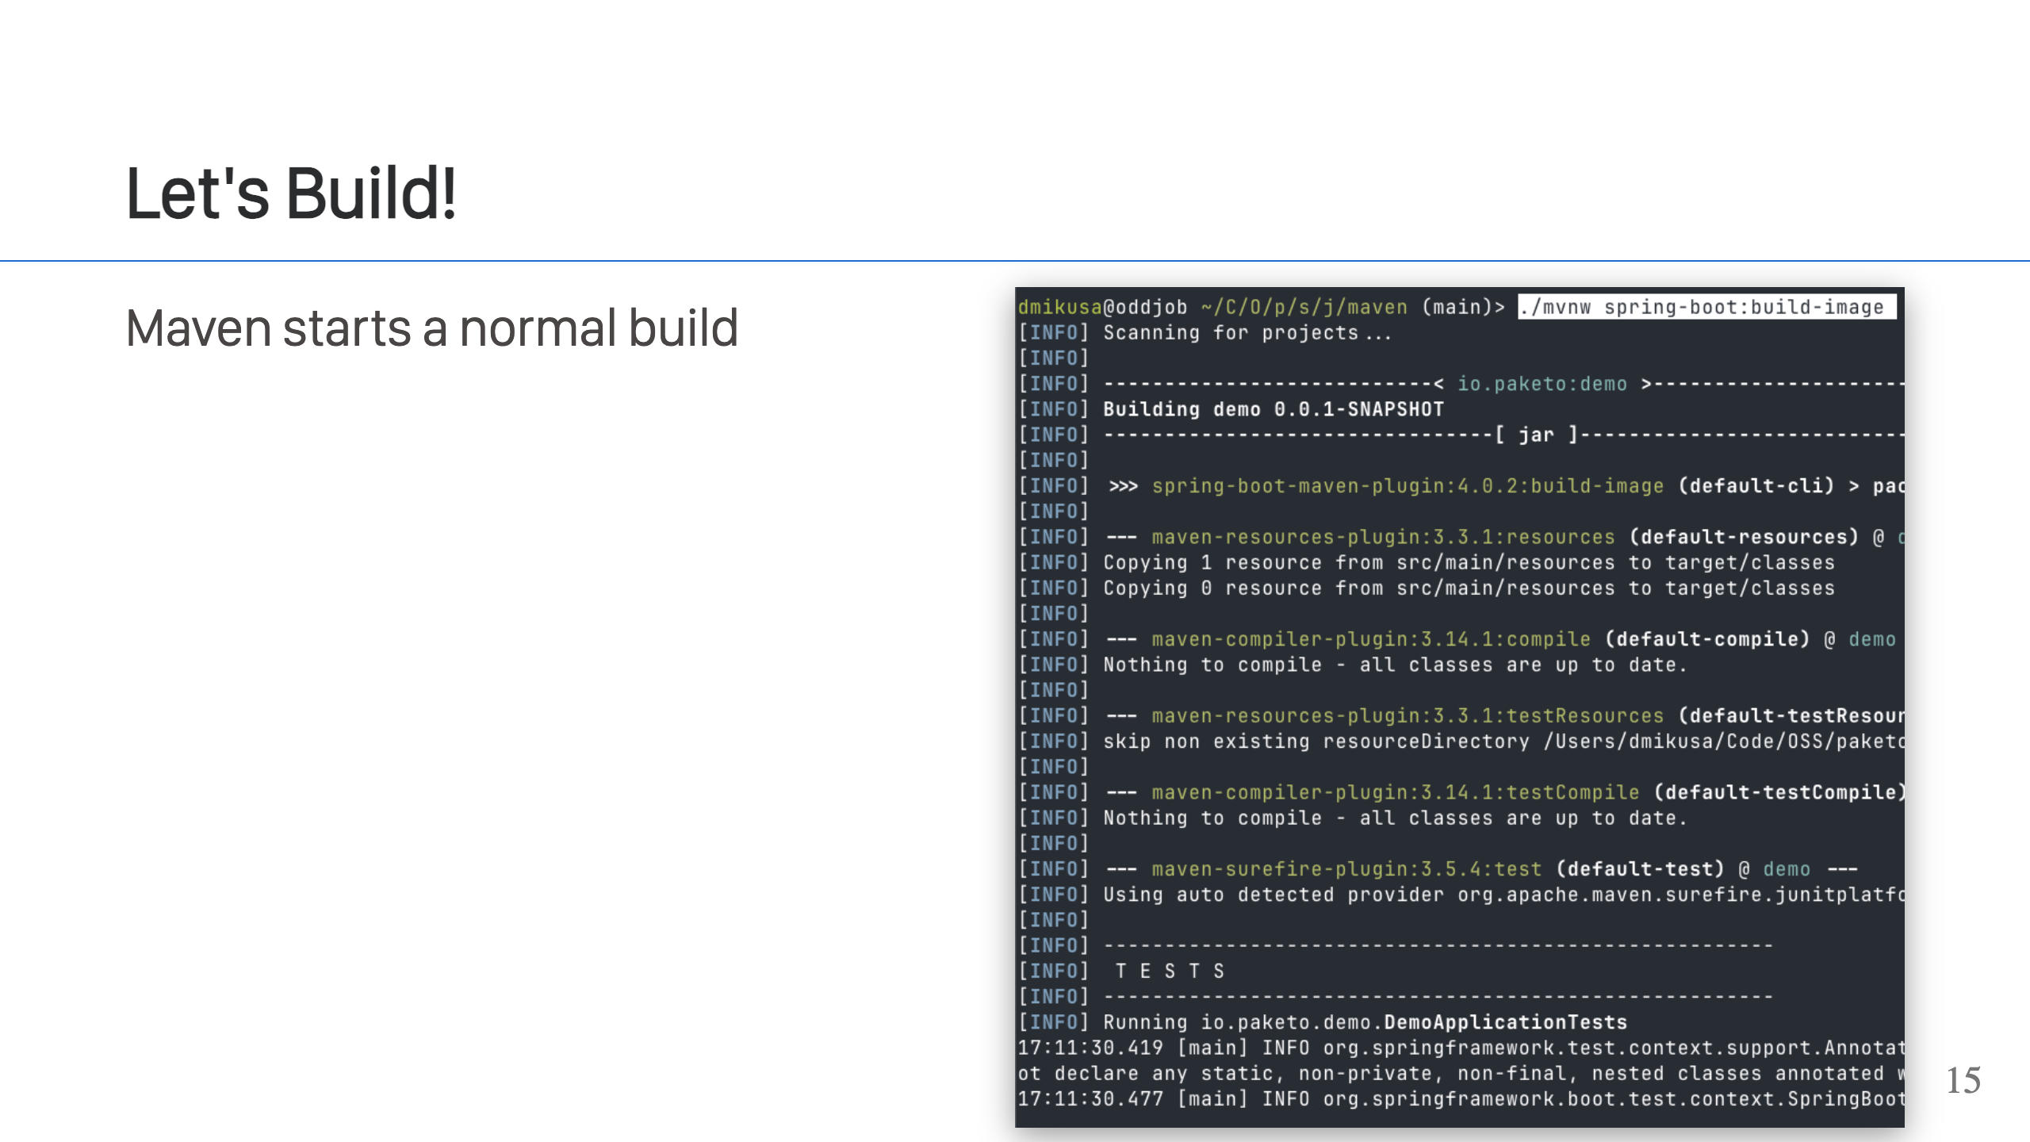
Notes:
Ok, so let's walk through a build! To get things started, we'll kick off the build using Maven. The process would be very similar if we used Gradle. If using `pack`, it'll be similar too but with a couple differences that I'll note during the build. In this case, we see that Maven starts with a normal build compiling code & running your tests. Nothing new to see here.

Slide 16
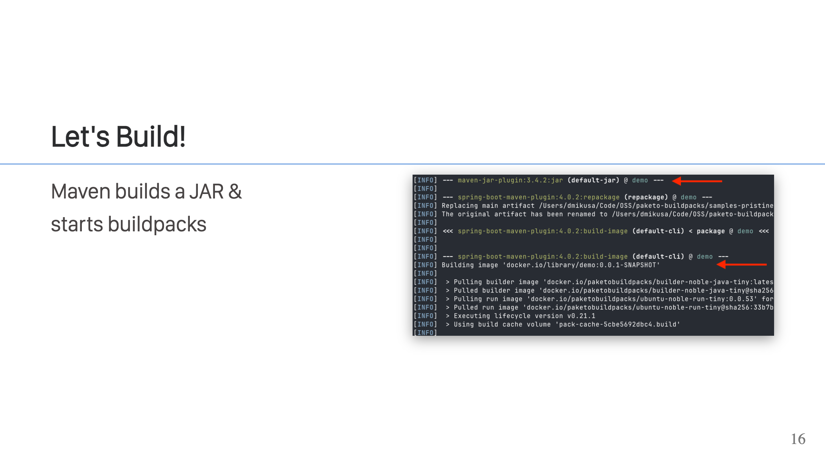
Notes:
After tests run, Maven will create a JAR file. The JAR file is used as input to the container build process with Paketo Buildpacks, and we can see the Cloud Native Buildpacks build start right after. The first thing you'll see the CNB build process do is to pull the required images. We see it pull a builder, a run image, and the lifecycle. It will optionally pull cache information, if it exists.

Slide 17
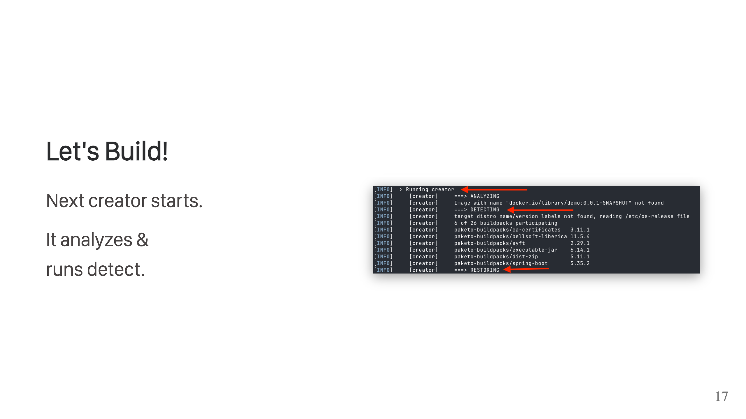
Notes:
The next step is for the lifecycle to run. The lifecycle has two different modes in which it can run, and in this case we see it running creator which essentially runs all of the build steps in one container. The lifecycle runs through the five stages of Cloud Native buildpacks. On this screen, we can see the first three. 1. Analyzing. In this stage, the lifecycle will look at the information that it has from previous runs. In this case, it's our first run so we don't see it doing anything. 2. Next we see the detection step. This is where all of the detect executable runs for each of the buildpacks. Buildpacks' detection executables all run in parallel and each buildpack outputs what is called a build plan. When all of the buildpacks are done, the lifecycle reviews the build plans and using the rules defined in the CNB specification selects a build plan to execute. Conversely, if it cannot select a build plan that satisfies all the rules, then it will fail. 3. Lastly, on this screen, we can see the restore stage. Information from analyze and detect is combined, and this is where metadata and cached layers are restored and made available to the next step: build.

Slide 18
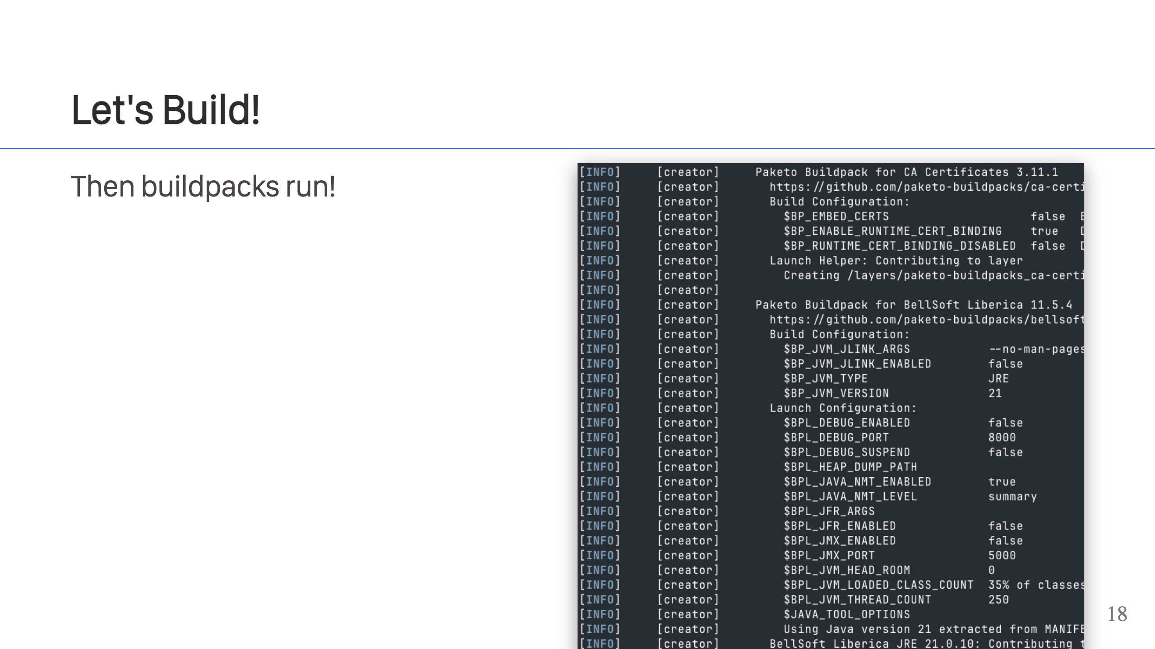
Notes:
This is where the buildpacks actually run. It's called the "build" stage. In it you will see the selected buildpacks run in the order defined by their build plan. This is the build plan that was selected in the detect stage. The build packs run and get access to the application code as well as any information restored from previous runs. The buildpacks themselves do not actually create any OCI images or layers, instead, they are responsible for creating a directory structure on disk and populating it with the files and information used to create the final OCI image and all its layers. This makes authoring buildpacks much easier, as all a buildpack needs to do is create/move files around on disk.

Slide 19
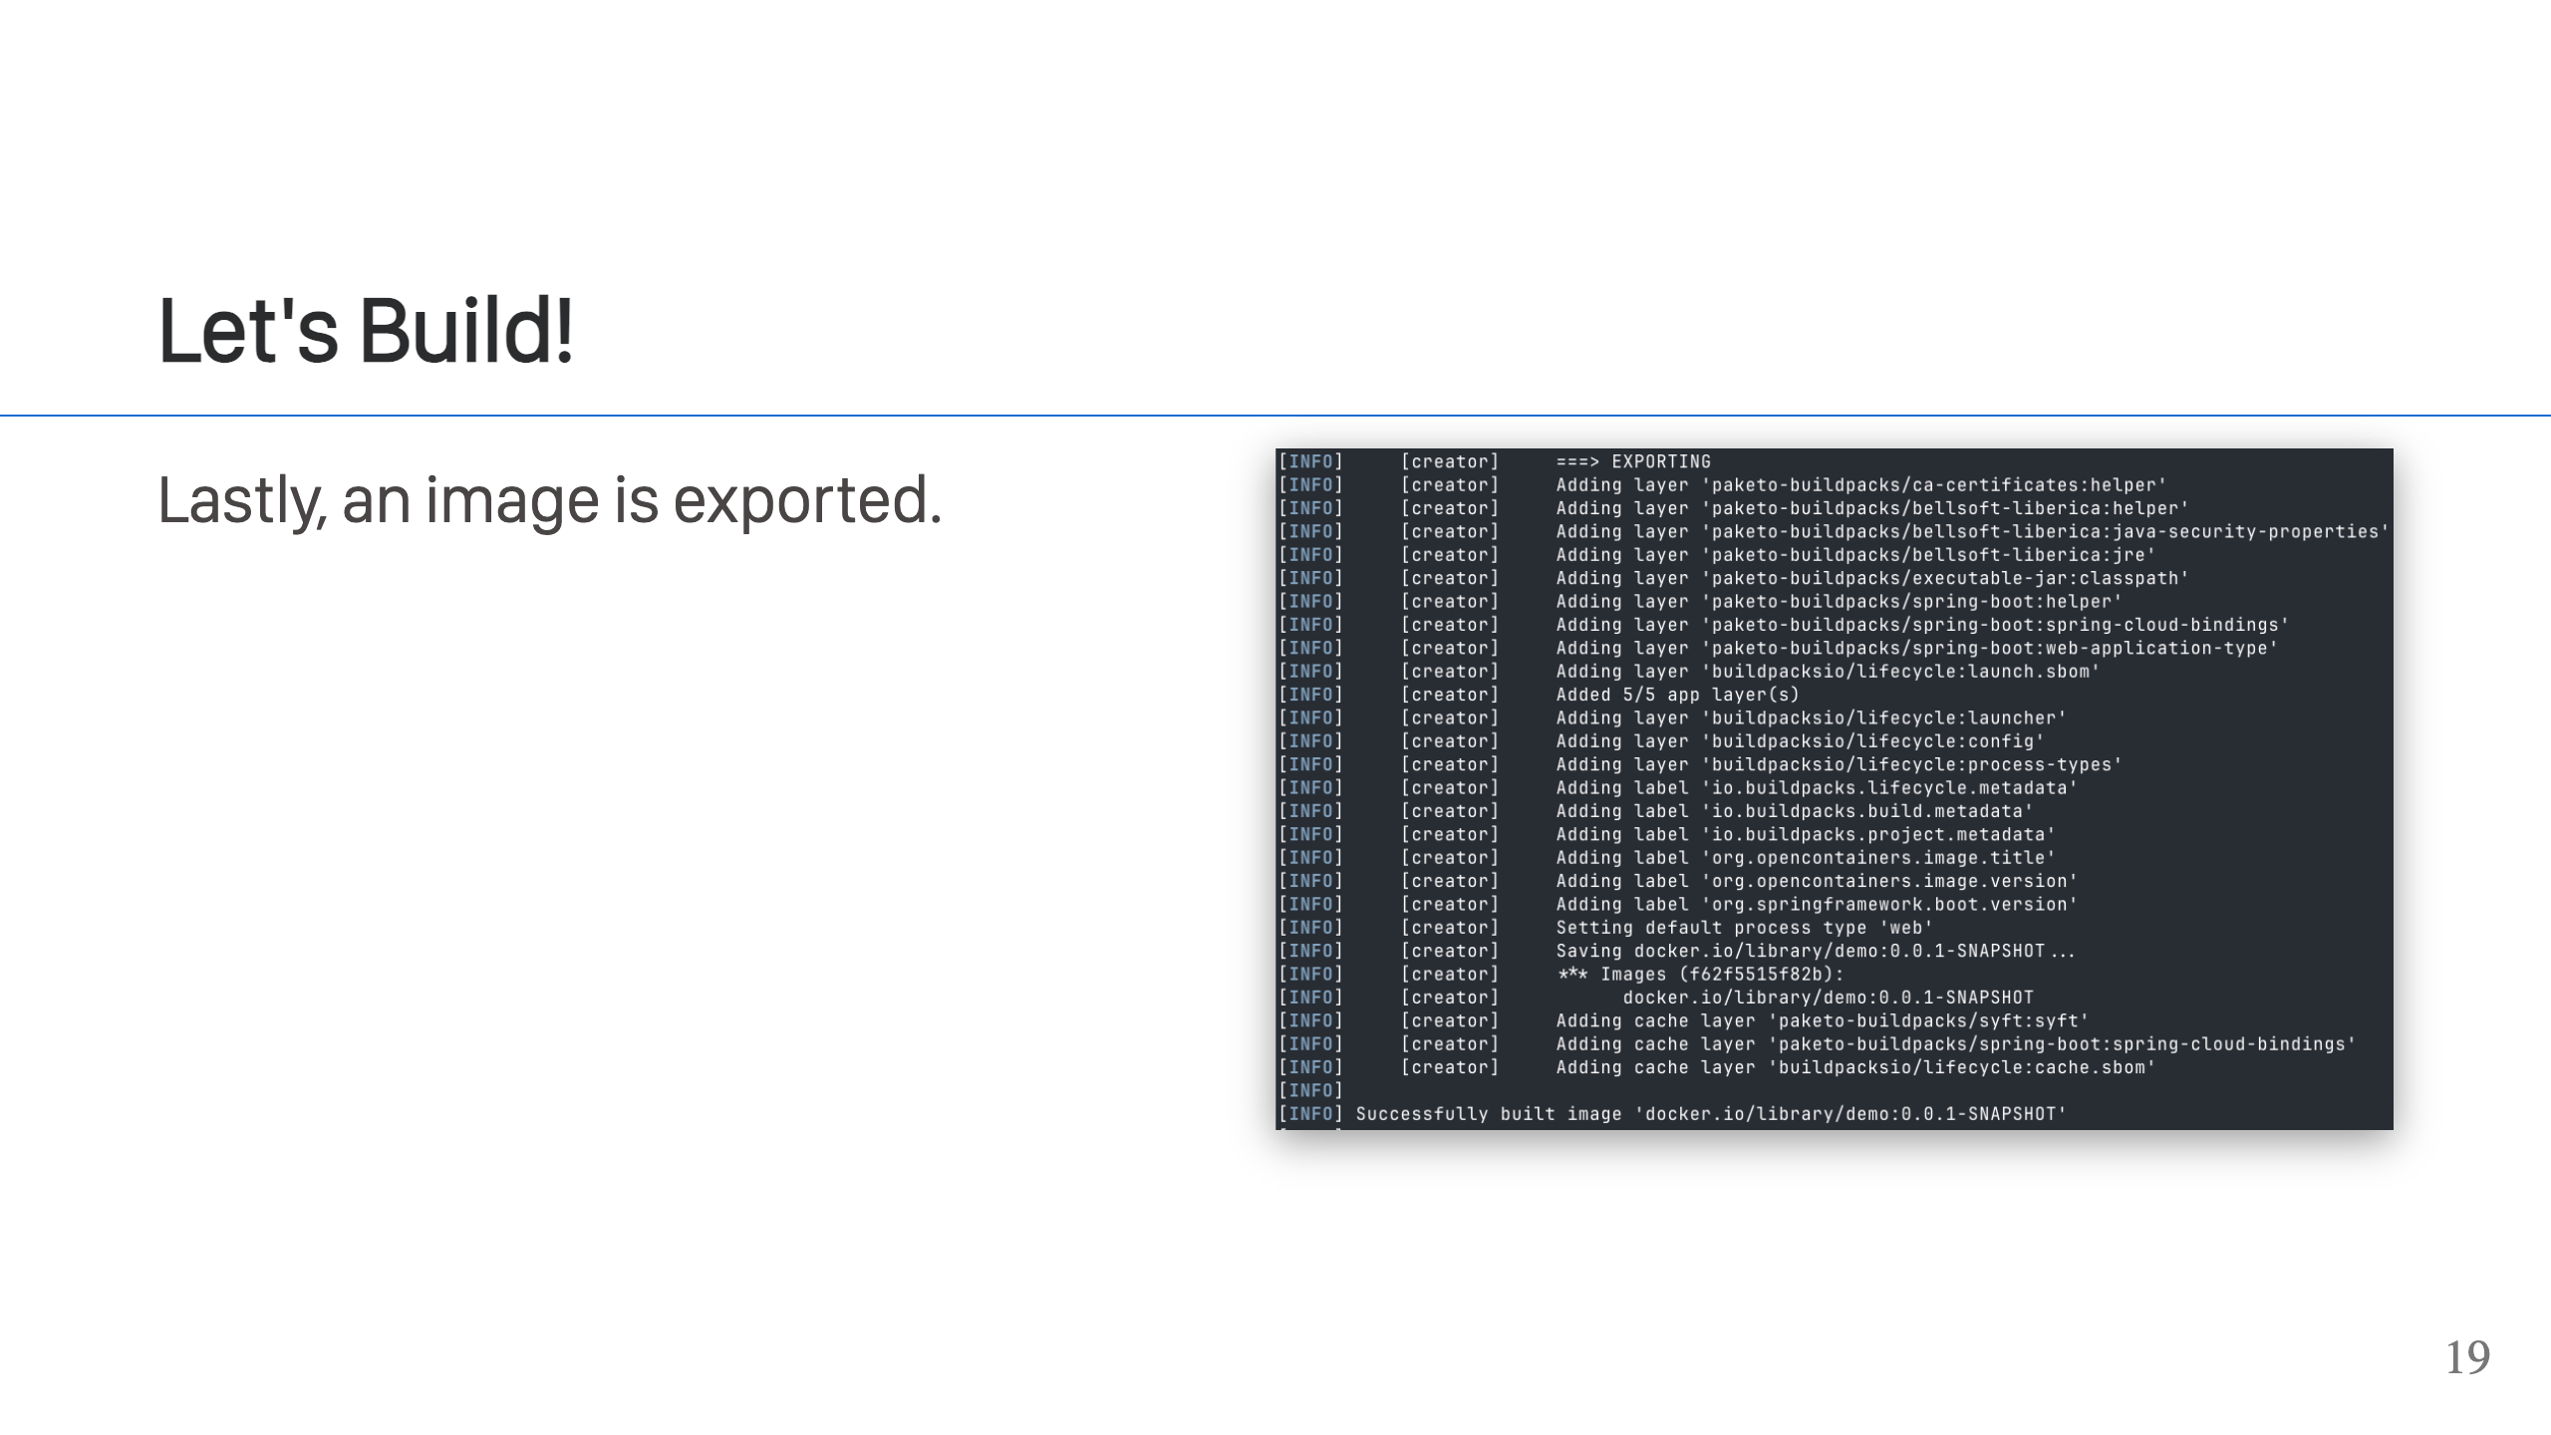
Notes:
The fifth and final stage of the lifecycle is to export the image. This process takes the specially crafted directory structure generated by the buildpacks and turns this into an OCI image. You can see in the output the image layers that are being created, and you can also see other metadata being written to the image, like labels. Finally, you'll see it write out the cache information that can be used by subsequent builds. This information does not end up in the application image though.

Slide 20
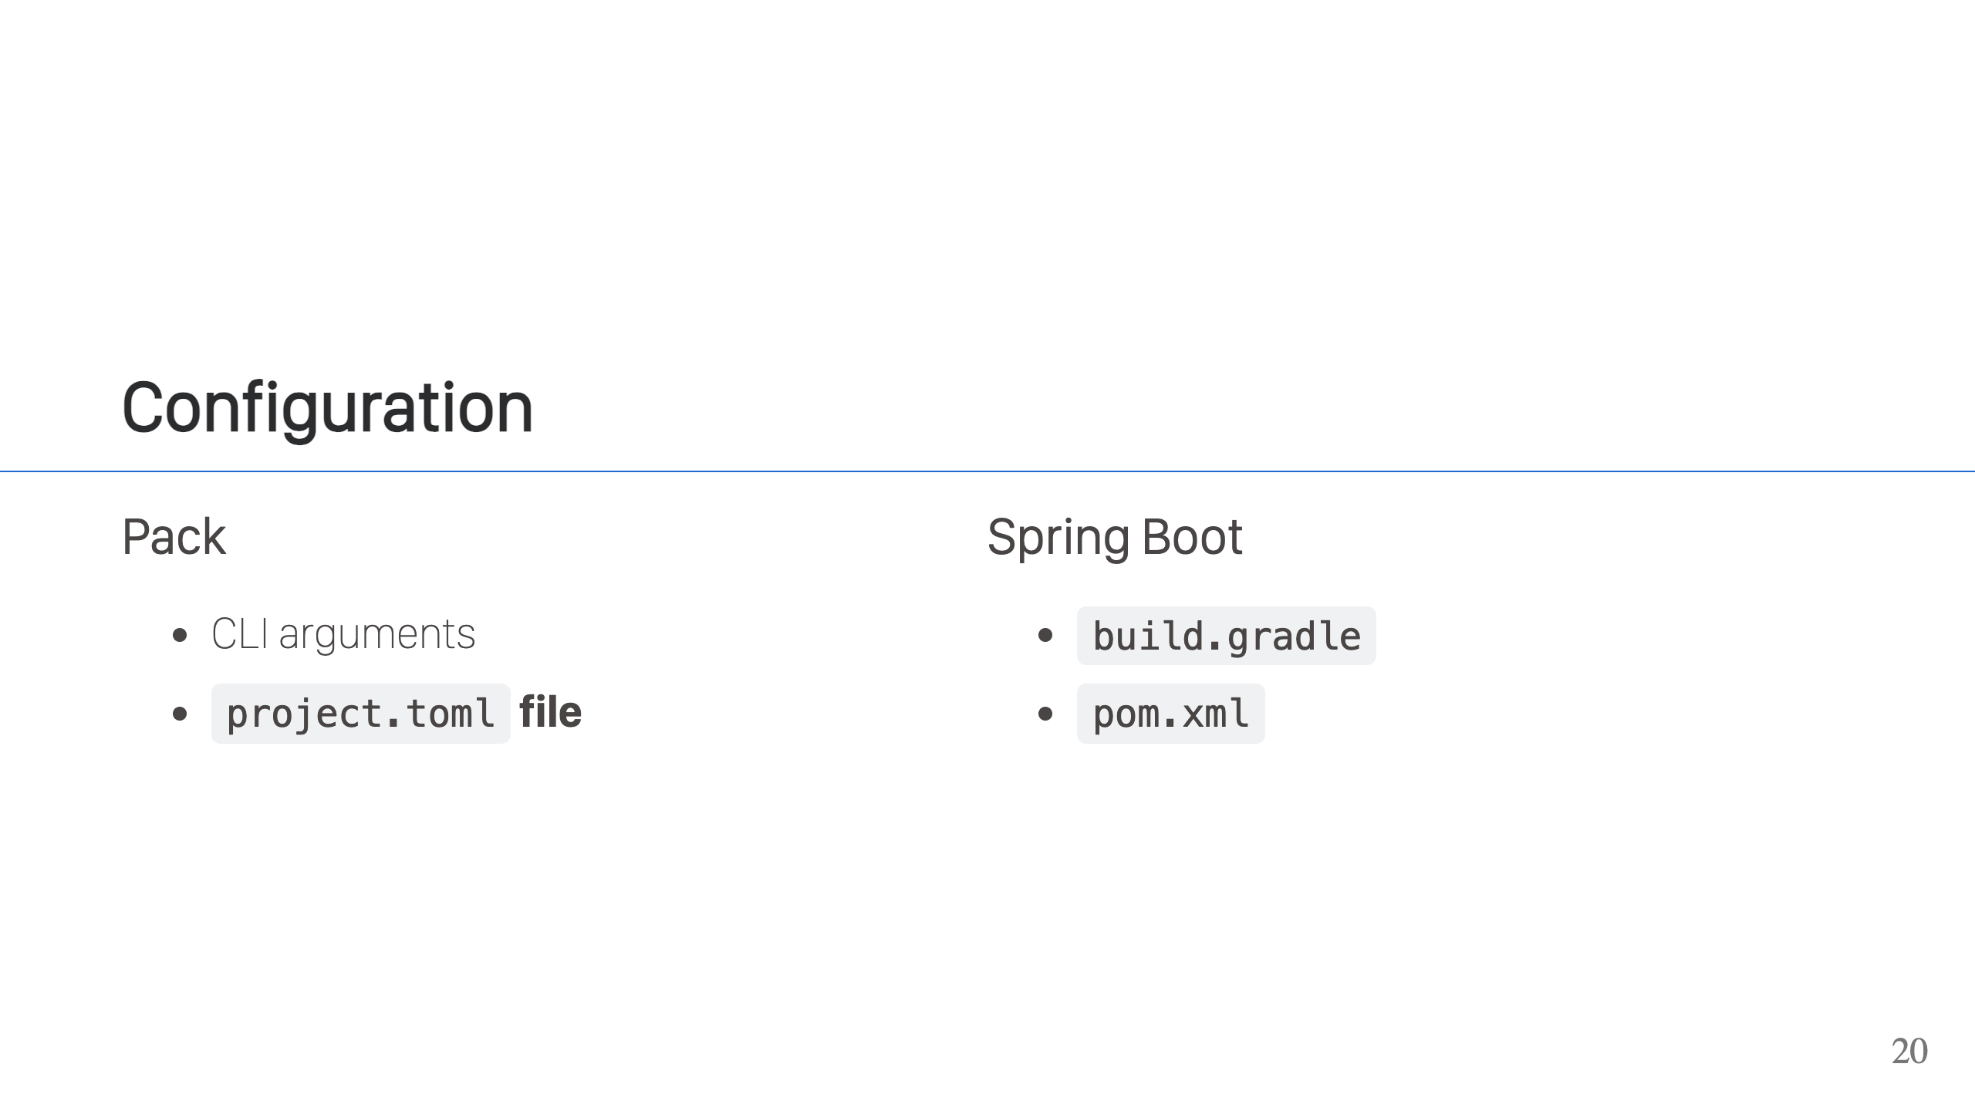
Notes:
Now that you've answered the questions above, you can take that and create a configuration that you can use to build your application. But how do you specify this configuration? For `pack` CLI users, you can specify this via command line arguments or via the `project.toml` file. Be sure to use the v2 format for `project.toml`, as this is more complete. For Spring Boot users, you can specify the configuration settings through the `build.gradle` or `pom.xml` depending on your build tool of choice. They both have a configuration settings section for buildpacks.

Slide 21
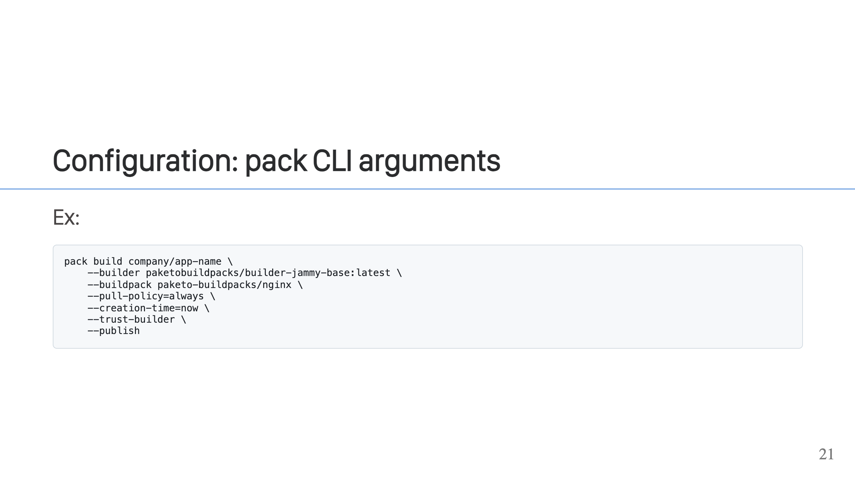
Notes:
This example uses `pack` cli to build an application. This is the most complete way of setting configuration, allowing you to set all options except include/exclude of files (although you can control what files are included to some extent with the `--path` argument). In this example, we give it the application name, we set a custom builder, and we set a buildpack to use. We could use the default builder, which we set with `pack config`. We could also have used the buildpacks that are present in the builder, but sometimes it's advantageous to just set the one or two you want instead. What this does behind the scenes is create a dynamic builder from the builder image and appending the buildpacks you've listed in a new order group. We are also setting the pull policy to always, which is a good production setting so you always have the most up-to-date images. We are setting creation-time to now, which gives you meaningful dates on your images. It does mean that for reproducible builds to work, you need to know what "now" was in order to reproduce the image. We then go on to set trust-builder which is good to set when specifying custom buildpacks. It just means that the tooling should trust the dynamic builder that gets created when you use the `--buildpack` flag. You should only do this if you actually trust the buildpacks being specified. Don't run buildpacks you don't know or trust. Lastly, we're setting the publish flag, which says to export this image to a registry and not the local docker daemon. This is typically what you want in your CI pipelines, but not what you want locally.

Slide 22
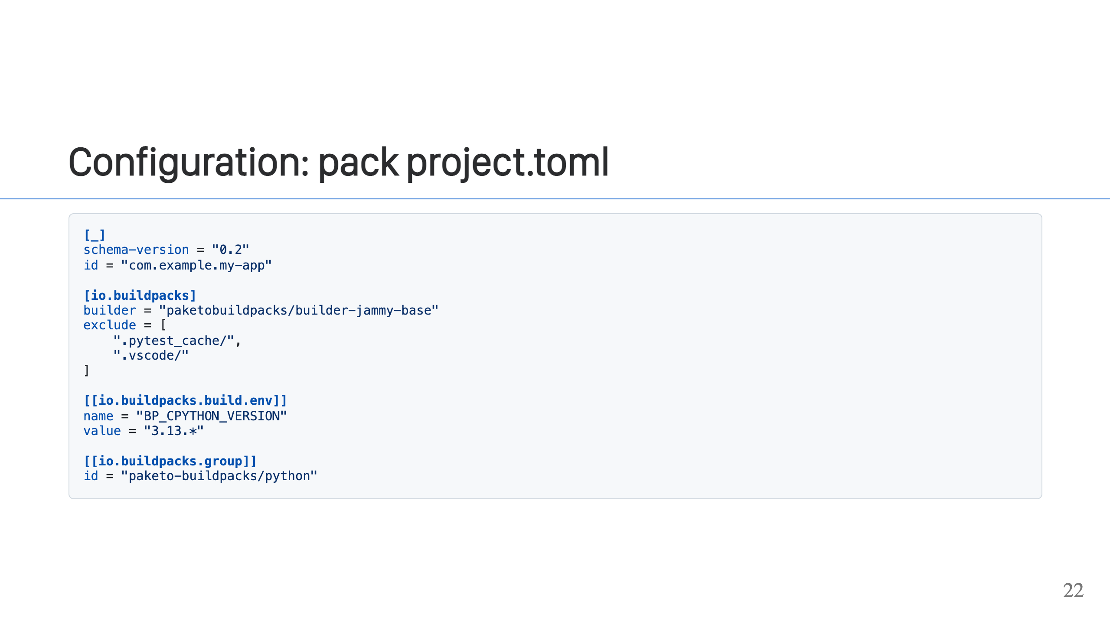
Notes:
In this example, we're using `project.toml`. This is a great way to set complicated setting like env variables. It's also the only way to set the include/exclude options. These work like a `.gitignore` file and prevent files from being pulled into your build environment from the local machine. In this case, we're also setting an environment variable and setting a buildpack to use. This is the same as the `--env` and `--buildpack` flags for the CLI. I like to use the exclude feature to trim things out of my build context. This keeps those things from polluting the build, and it keeps them from ending up in the final app image as well. For this reason, I almost always have a `project.toml` with at least that setting.

Slide 23
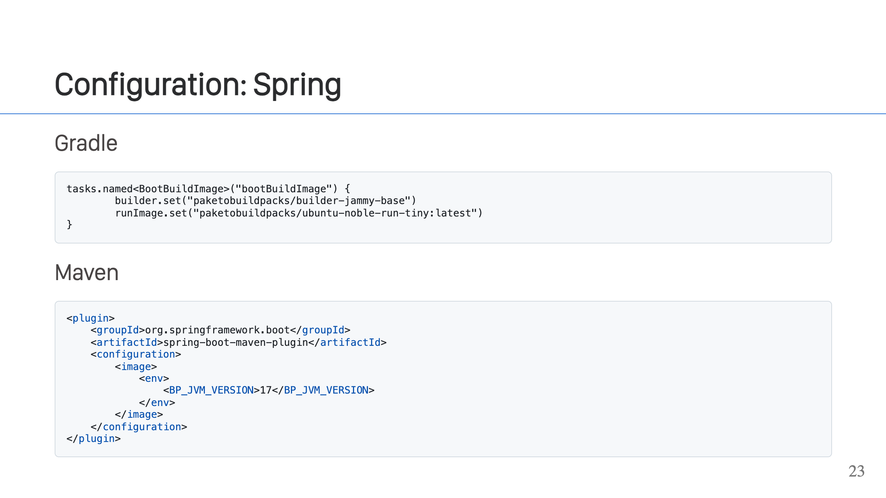
Notes:
In these examples, we're using our Spring Boot configurations to house the configuration for our builds. In the first example, we're using our `build.gradle` file. This is setting the builder and run image. In the second example, we're using our `pom.xml` to configure an environment variable for defining the Java version we want to use in our build. The Spring Boot Build Tools offer a wide variety of configuration options that you can use to configure the app, [with Gradle](https://docs.spring.io/spring-boot/maven-plugin/build-image.html) and [with Maven](https://docs.spring.io/spring-boot/gradle-plugin/packaging-oci-image.html).

Slide 24
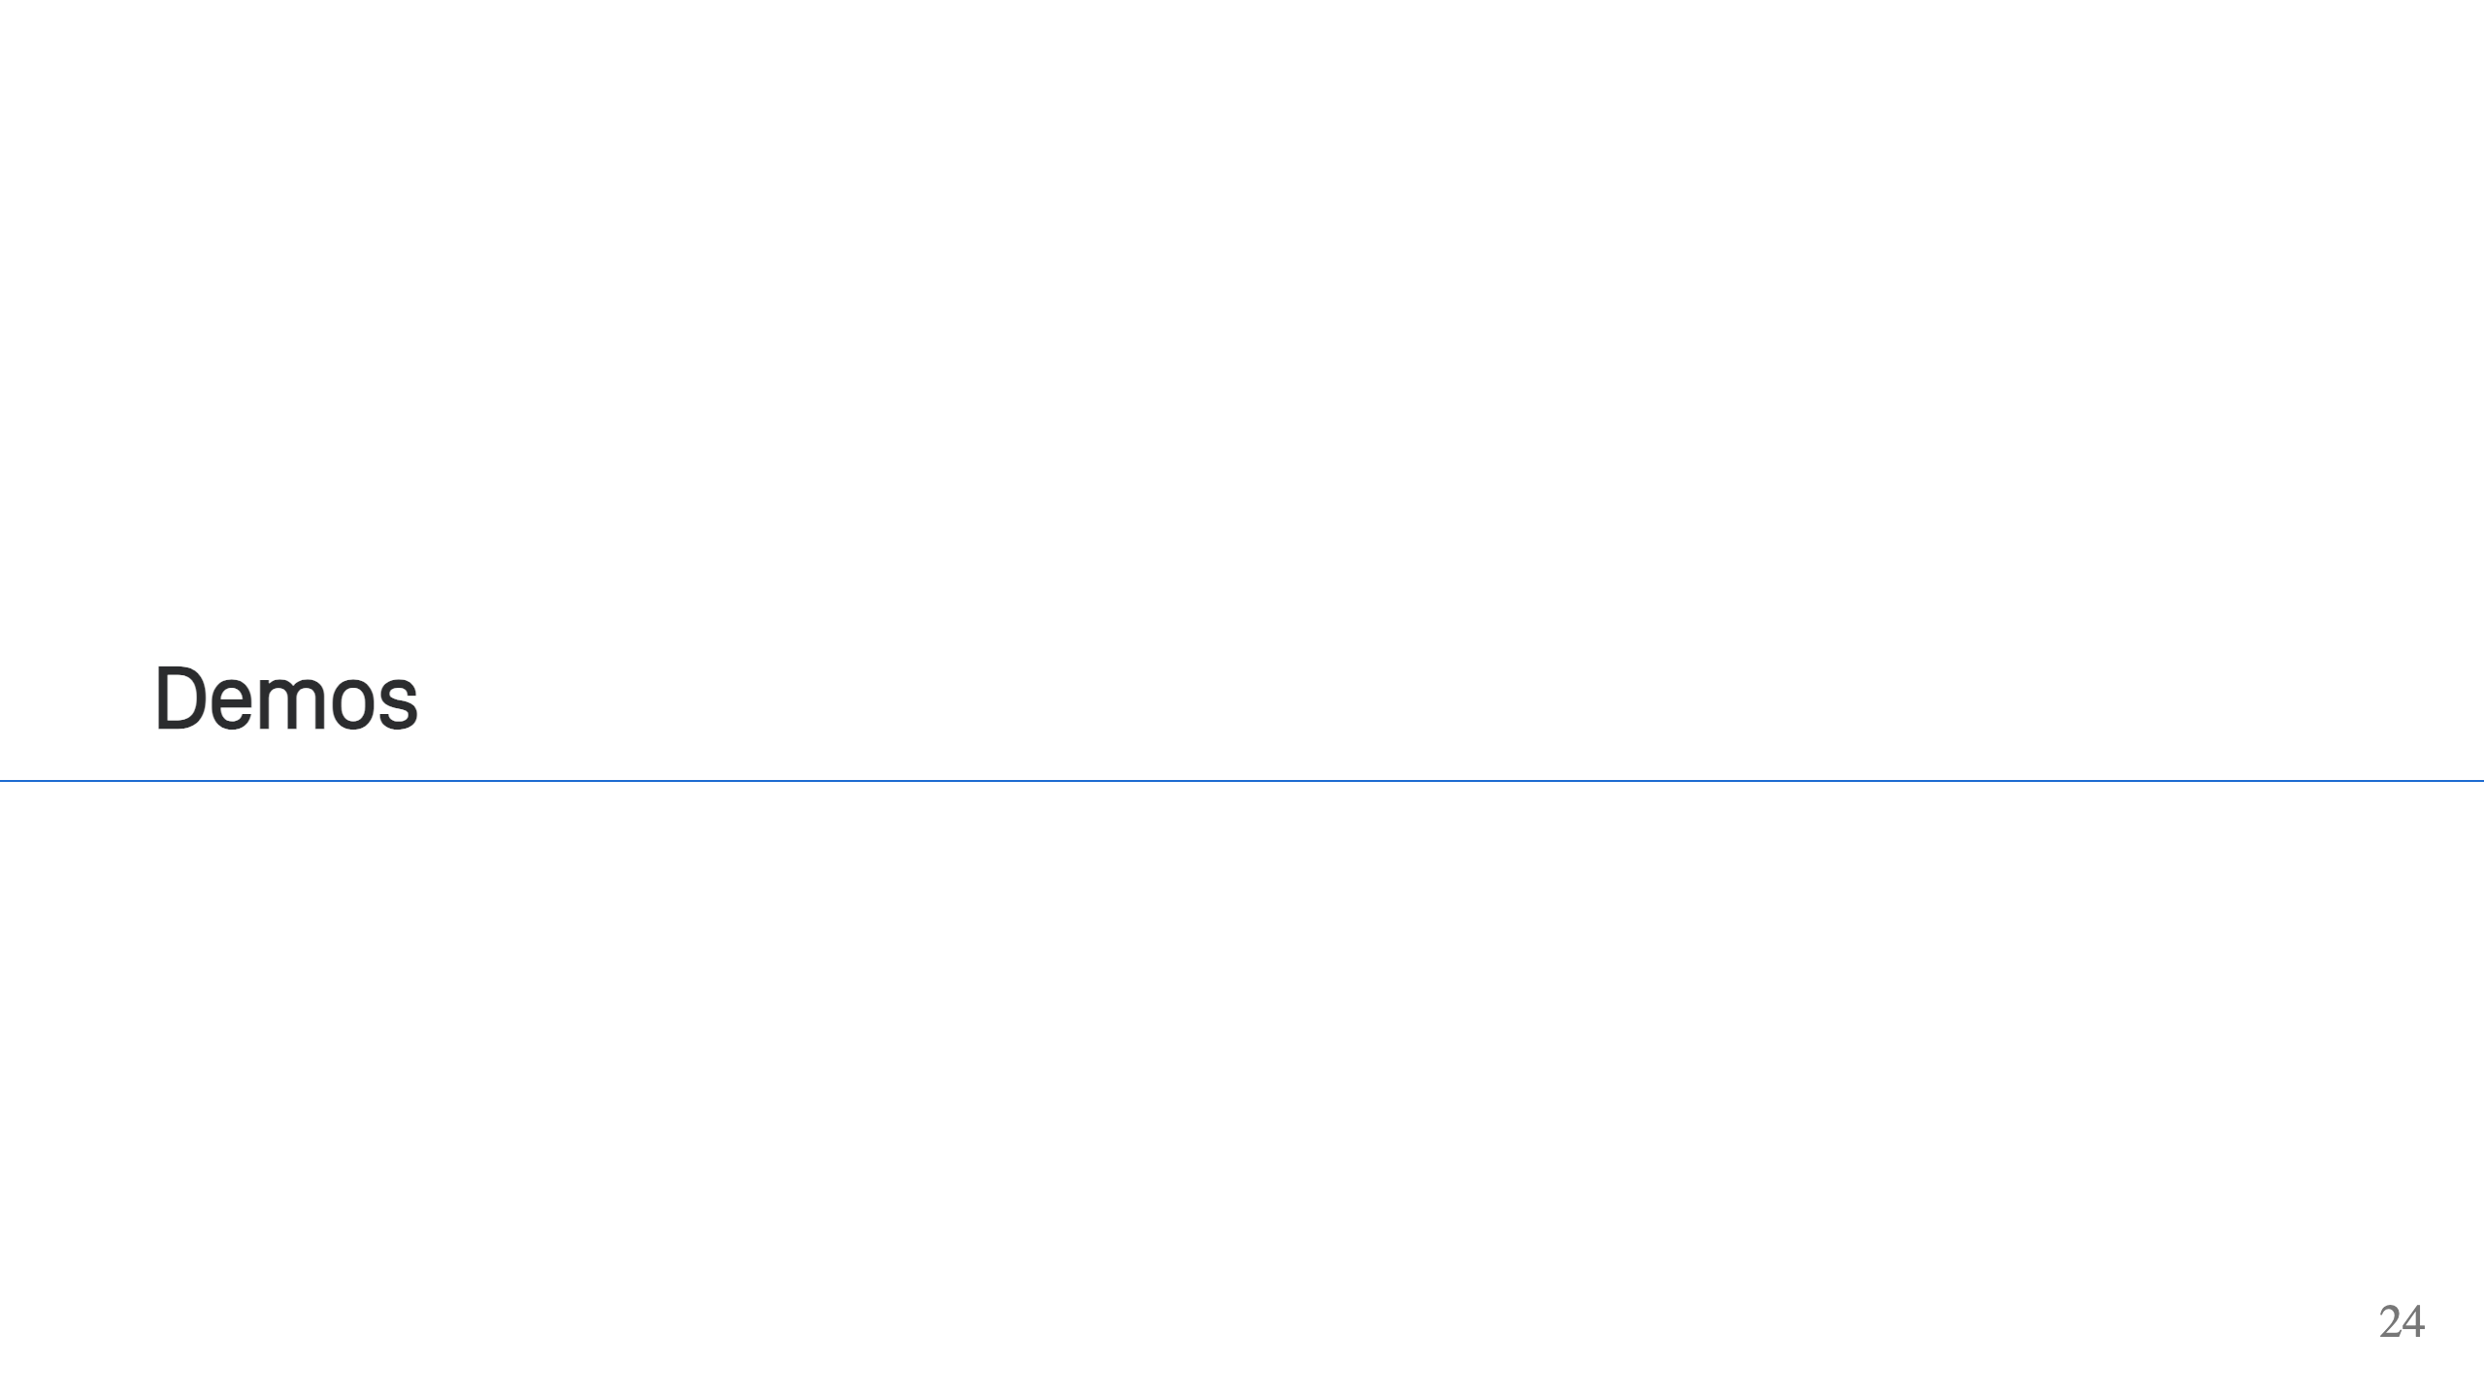
Notes:
Run through the following demos: - Spring Boot app build from source - Spring Boot app build from jar and customization some settings like JVM version & vendor - Static HTTP apps - Python app, show how they’re all similar - Maybe something with a custom start command

Slide 25
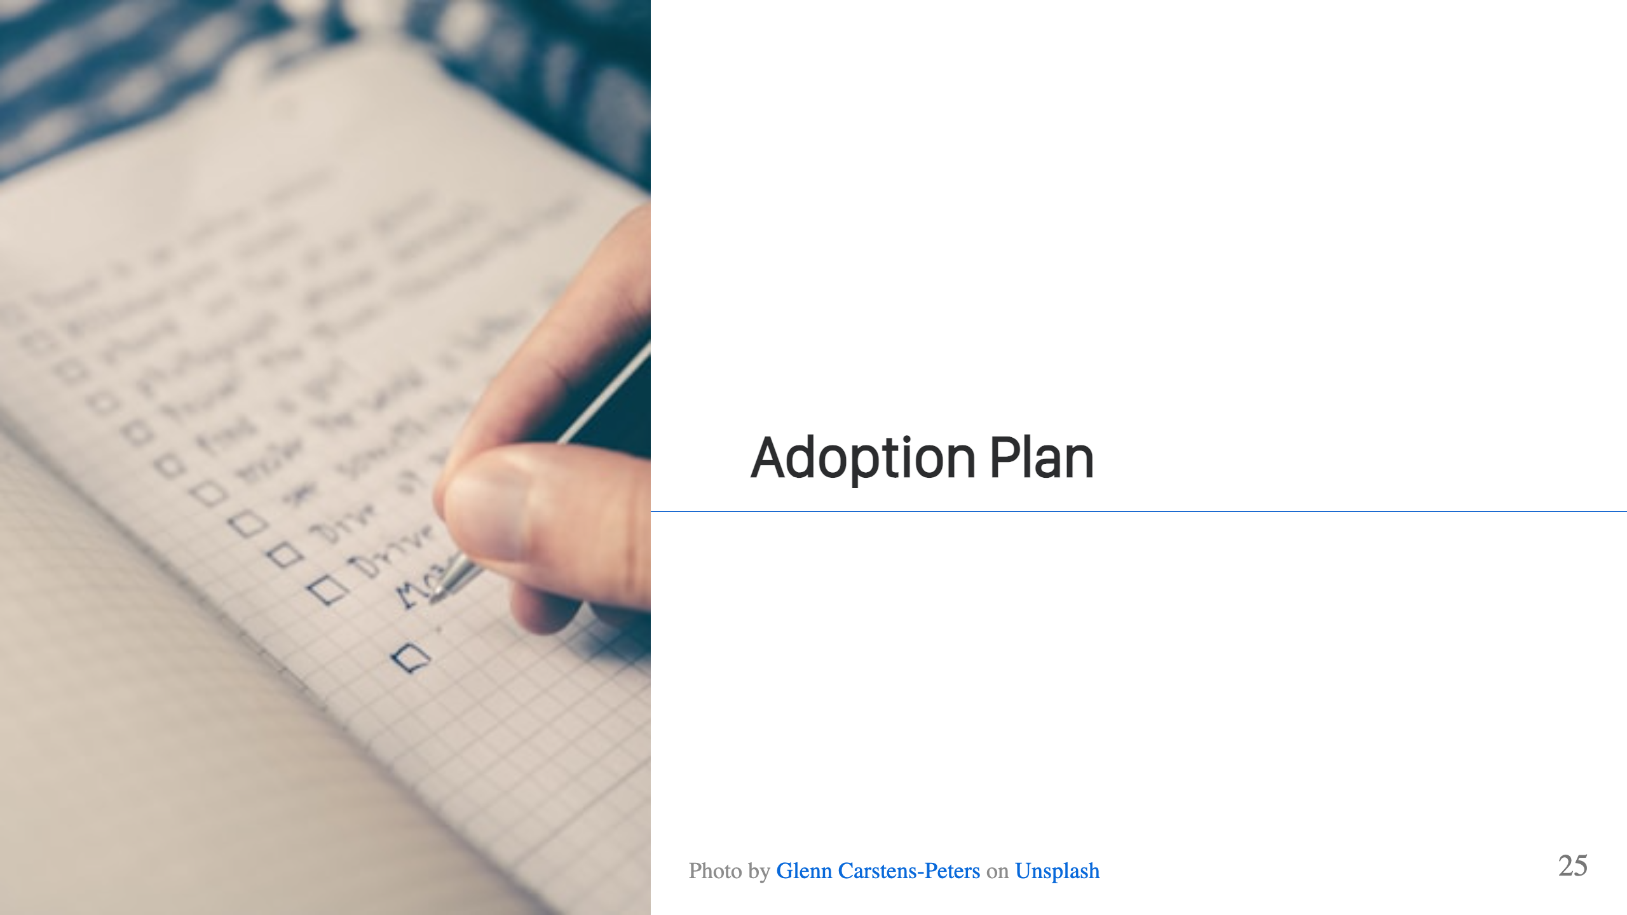

Slide 26
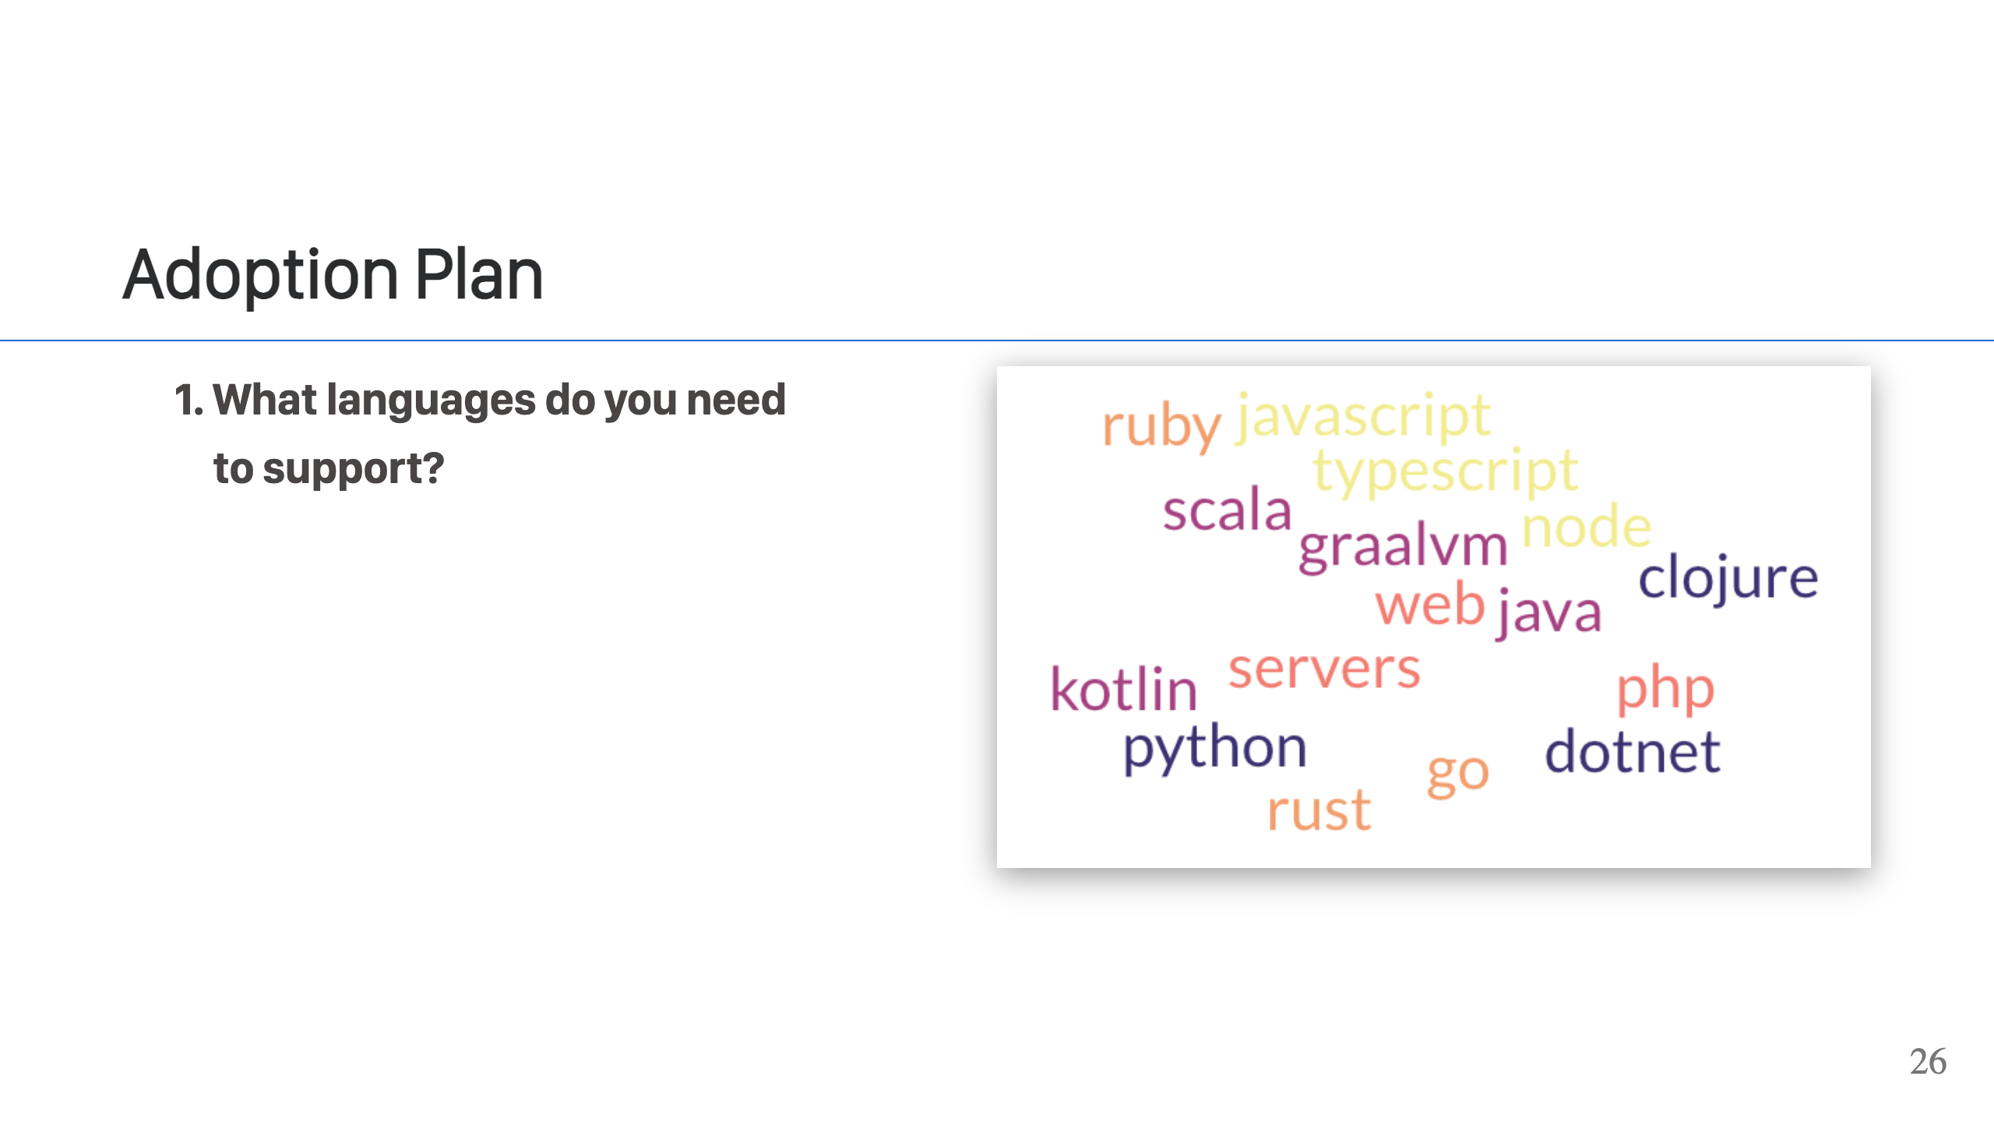
Notes:
Now that we've seen Cloud Native buildpacks & Paketo in action, let's take a step back. When I'm preparing a new application, I have a set of a few questions I'll walk through to plan out the process. The first question is regarding programming languages that you need to support. I love Paketo, which supports Java, GraalVM, Scala, Kotlin, Clojure, .NET, Python, Node.js, Go, Rust, Ruby, PHP, and Web Servers. Make a list of the languages you need to support. If you need support for languages not in this, then you will want to check out the [Buildpack Registry](http://registry.buildpacks.io/), where you can look for existing buildpacks that support the languages you require. If you can't find any buildpacks that support your language, then you would need to create one to support that language or not use buildpacks for that language.

Slide 27
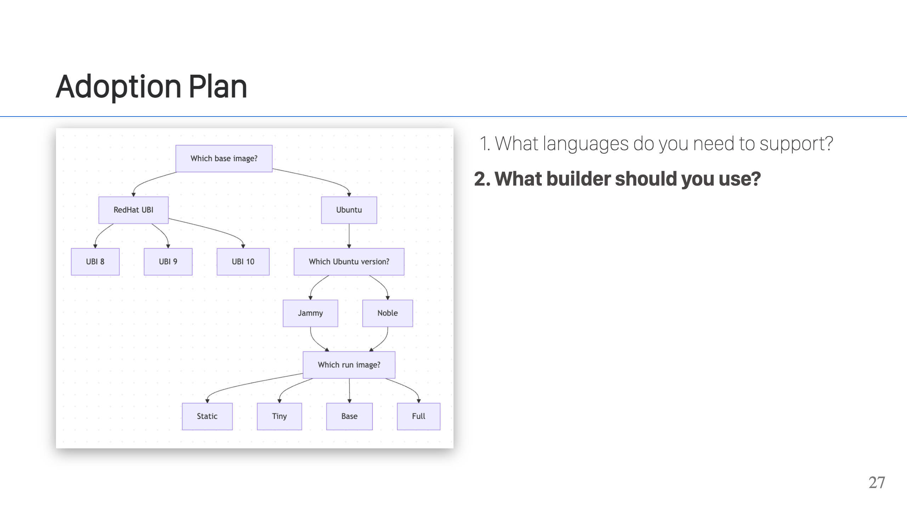
Notes:
Next, you'll want to select a builder. If you're company uses RedHat base images, then you'll want to go with one of the UBI builders, 8, 9 or 10. If you want to use Ubuntu base images, then you'll want one of our Ubuntu base images, either Jammy or Noble. From there, there are four different sized images you can choose from based on your needs. Generally, the smaller images are better, but like most things in tech, it depends. Static is the smallest and works for Go & Rust apps. It only has CA certs & timezone data. It is around 5-8M. Tiny is a little larger, including CA certs, timezone data, libc/libgcc, libstdc++, zlib, and openssl/libssl. This is suitable for Java, GraalVM, Scala, Kotlin, Clojure, Go, Rust, and Node.js applications. It is around 16M. Base is larger but still quite reasonable. It includes all of time, more libraries, and is the smallest image that includes a shell. This is important to know for troubleshooting purposes. If you need to get into the container, then you need a shell. This image also includes `apt` so it works as a good base if you need to include additional libraries or packages. It supports languages Java, GraalVM, Scala, Kotlin, Clojure, .NET, Python, Node.js, Go, Rust, Ruby, and Web Servers. It is around 90M. Full is the largest image, and has way too much stuff in it. Last I looked, it weighed in around 1G. It is not recommended that you use full unless you absolutely have to. If base is missing something you need, then using base and adding a few packages is the recommended path. That will result in a much smaller image. For the time being, PHP apps do need full because of all their required OS level dependencies, however, the project is hoping to address this and support PHP on the base images.

Slide 28
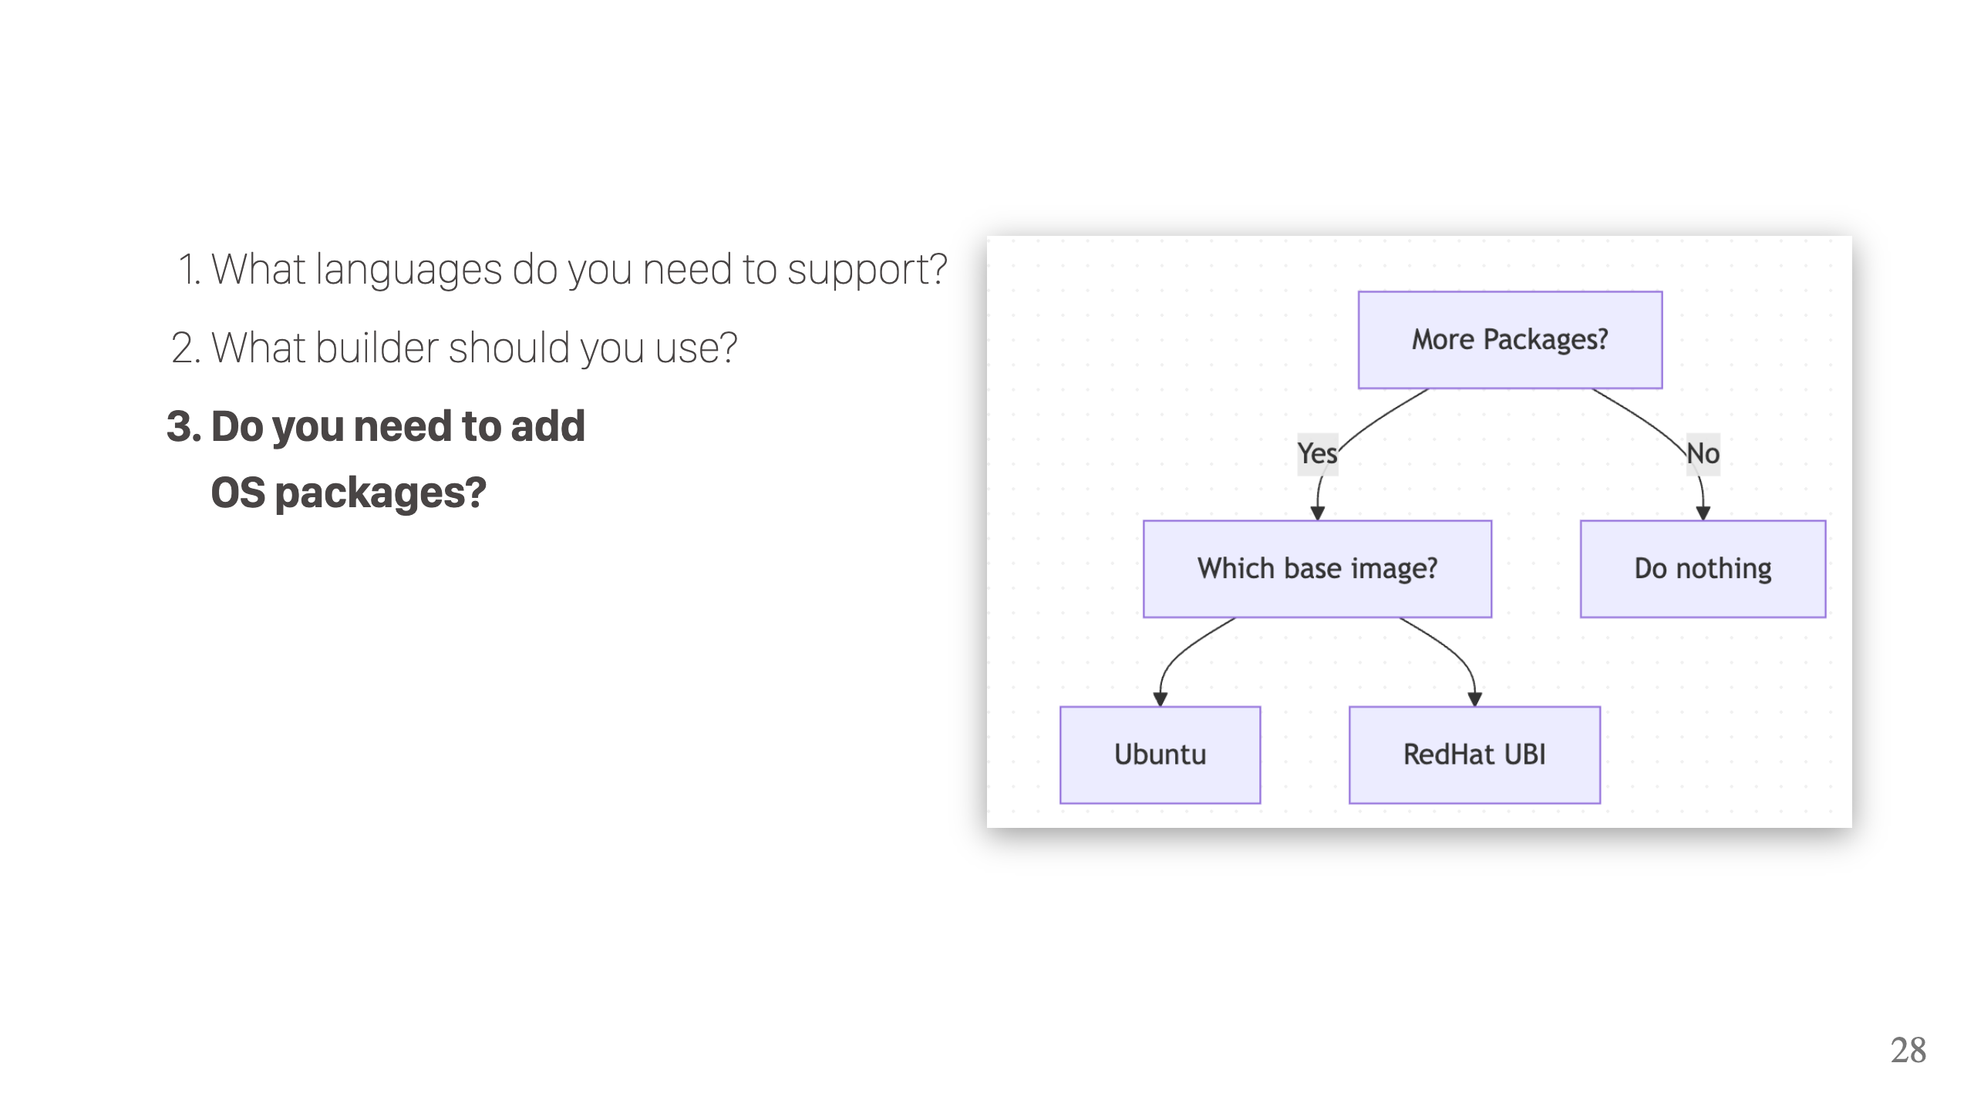
Notes:
Another common issue is needing to install additional OS packages. This often comes in the form of needing additional dev libraries, like for a database, which are not present in the base images. How you do this depends on your choice of base image. If you are using the Ubuntu base, then you can use the Paketo Apt buildpack. This buildpack is given an `Aptfile` with a list of packages to install. It will then install them into a buildpack layer and set env variables to make the packages accessible to your application. This is *NOT* installing them into the base layer, so this doesn't work for all packages but it does well with most things you need to install for buildpacks. If you're using the UBI base images, then it's a little trickier. You would need to make a custom image, as we do not presently offer an RPM buildpack.

Slide 29
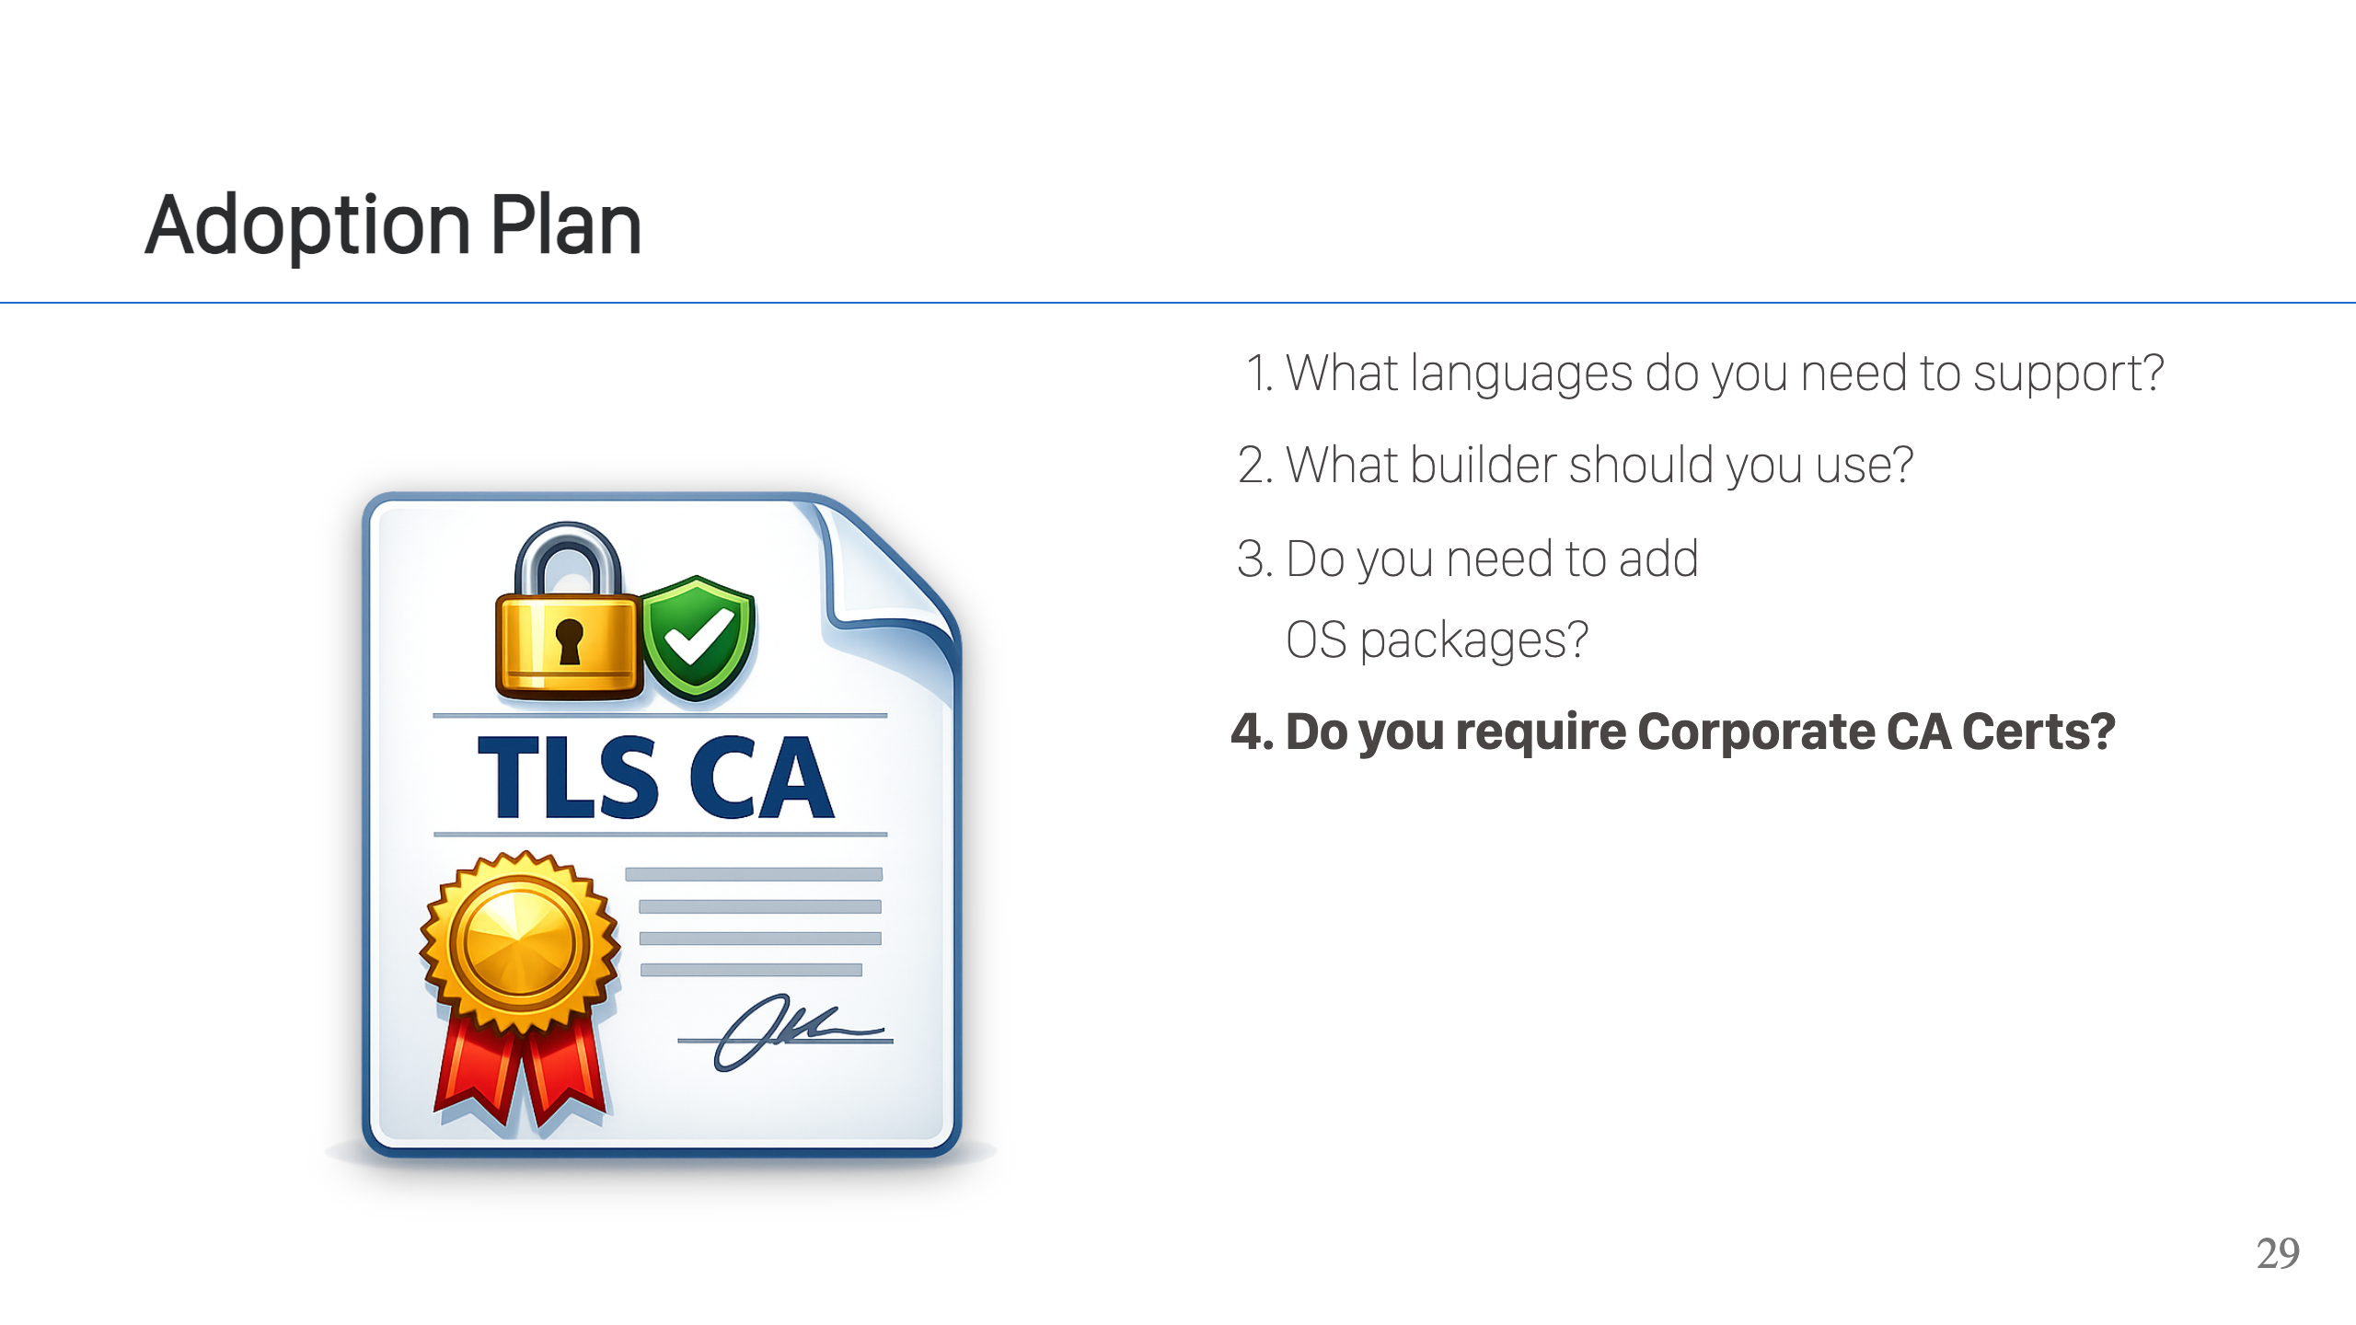
Notes:
Another common situation, especially at large companies, is to require the support of custom CA certificates when making connections to the Internet. These custom CA certificates are generated by your company and allow the company to intercept encrypted traffic, decrypt it, and monitor it. Because the company requires these custom CA certificates, if your connections do not trust them, then your connections will fail. This extends to buildpacks fetching dependencies for you from the Internet or even your application talking to other services on the Internet. Fortunately, this is something that Paketo Buildpacks supports. The ca-certificates buildpack will take your company's CA certificates and install them into the container for you. These are set up in a way that's compliant with OpenSSL, so any application that uses OpenSSL for it's TLS support will correctly pick up these CA certificates. One notable stand out that does not use OpenSSL is the JVM. The JVM maintains its own CA certificate lists. Because Paketo Buildpacks has great support for Java application, we have this case covered as well. If you are building a Java application, the Java buildpack will also pull in the CA certificates to the JVM's truststore, so the JVM will properly trust the CA certificates as well.

Slide 30
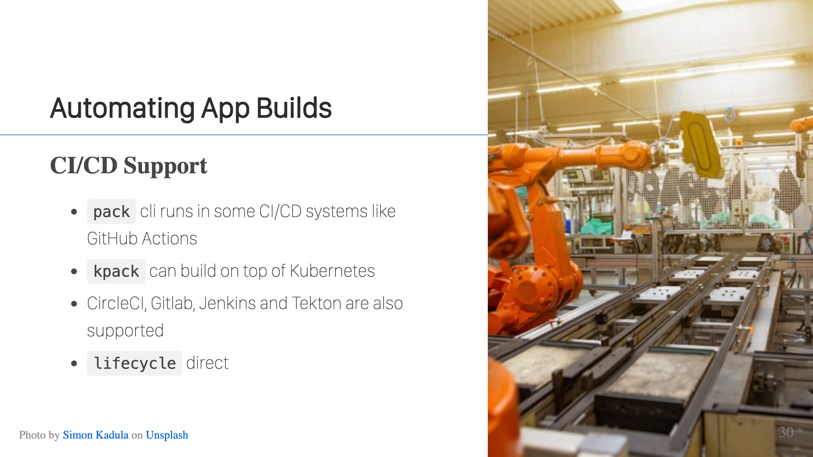
Notes:
For some CI/CD systems, you can just run `pack` directly. For example, GitHub actions have a Docker Daemon available, so you can use pack to do builds. There are some CI/CD systems that run in containers, so don't have a Docker daemon (don't mess with Docker in Docker). These have specific integrations provided by the CNB project, CircleCI, Gitlab, Jenkins, and Tekton fall in this category. Finally, there are some CI/CD systems where you can pick the image in which your job will run. Concourse is like this. In this case, you can set the image for the job to be your builder image. Then you can invoke the lifecycle directly and it will execute the build. This is essentially what pack is doing for you, it creates a container with the builder and runs the lifecycle. In this case, the CI/CD system is creating the container and we manually invoke lifecycle to run the build. The only note with this last approach is that you will need to publish directly to the OCI registry, since there is no daemon. This can actually be faster though, so it's not necessarily a bad thing.

Slide 31

Notes:
Slides are available at the link above.

Slide 32

Notes:
Feedback can be left at this link. It's open for 1 hour after the talk.

Slide 33


